Slide 1

Processing and analysis of marine data using modern program languages
Marchuk Institute of Numerical Mathematics
of the Russian Academy of Sciences
Natalia Zakharova, Natalia Lezina
Vladivostok, 2019

Slide 2
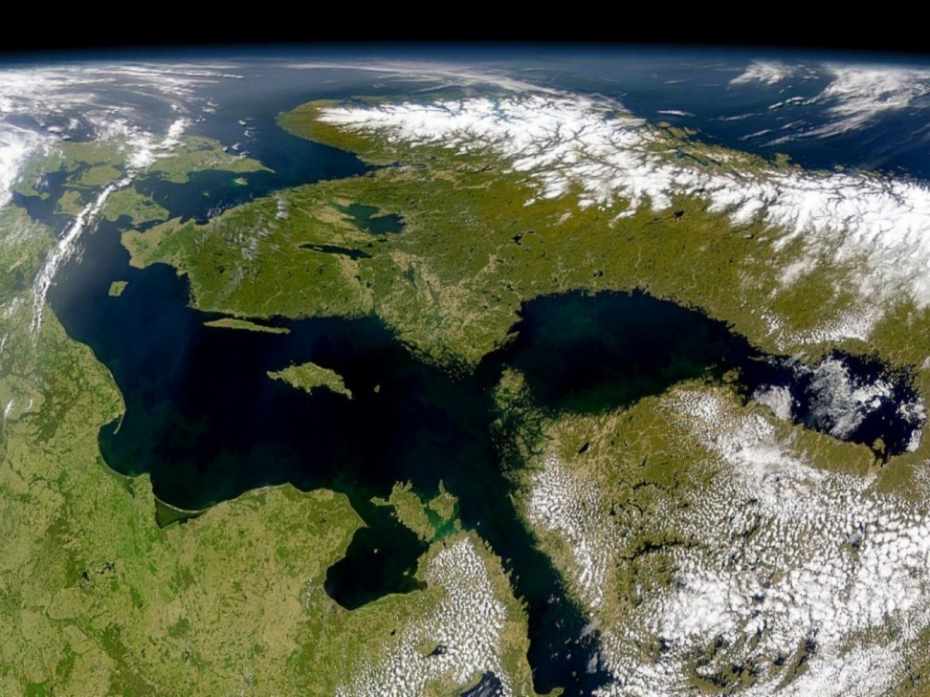
Introduction
Currently, the development of observational systems for monitoring the state of the environment is being actively developed, and therefore the number of observational data is growing rapidly.
This work is devoted to the processing of hydrophysical data on the state of marine areas by means of modern data processing technologies

Slide 3
Data processing
Data processing:
  Receiving,
  Verification
  Interpolation
Data analysis:
  Calculation of statistical parameters,
  Highlighting common features that are characteristic of the entire data set,
  Highlighting data trends,
  Dependencies between parameters

Slide 4
Data processing
In the research the Python [1] programming language for marine data processing were used.
The present study is conducted in two areas - the Black and the Baltic Sea. Satellite data were processed using Python scripts for both water areas.
The analysis of the obtained information was conducted by means of R programming language [2].
Temporal and spatial variability of the surface temperature within considered areas studied
[1] M. Lutz Programming in Python. V.1 / М. Lutz. - Moscow: Simbol. - 992 p., (2016). (in Russian)
[2] R Core Team (2018) R: A language and environment for statistical computing. R Foundation for Statistical Computing, Vienna, Austria. (https://www.R-project.org/)

Slide 5
Data processing
Two modern programming languages were used to process this data:
Python and R.
The Python is a high-level, general-purpose, performance-oriented programming language. The language is distinguished by its convenient syntax and ease of use, it allows one to work quickly and integrate different software components into a single system. A set of scripts for receiving data from the Service and converting them into the required formats is implemented using Python.
The daily SST data of the Black and Baltic Seas for the years 1982-2018 were processed using the implemented set of scripts. The using of the Python is convenient for solving problems of receiving and processing data as well as for integrating the codes for various applications.
Data processing:
Receiving, Verification,
Interpolation

Slide 6
Data analysis
Two modern programming languages were used to process this data:
Python and R.
Data analysis:
Statistical parameters,
Common features that are characteristic of the entire data set,
Data trends
To perform the data analysis programming language R was used. The language has been developed by scientists mainly for statistical data processing and is available free of charge. The R supports a wide range of statistical and numerical methods; its data visualization is implemented conveniently. Using the R allows one to efficiently analyze data, distinguish structures and anomalies in data sets, identify and investigate regularities using statistical methods.
Using the capabilities of the R the analysis of observational data on the Black and Baltic SST for 1982–2018 was carried out.

Slide 7
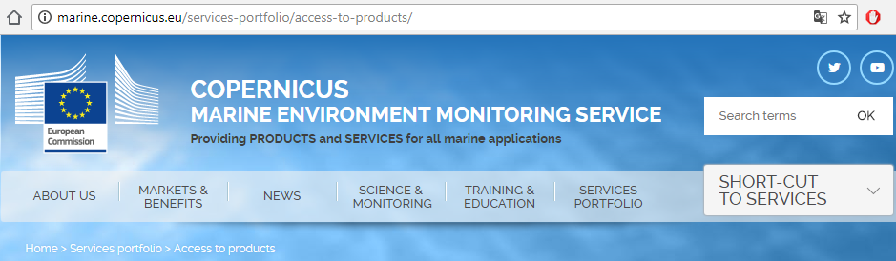
Data
Data provided by Copernicus Marine Service were used in the study (http://marine.copernicus.eu/). The Copernicus project is an international Earth observation program that provides an opportunity to study, research, and monitor the environment.
The data observation on the surface temperature of the Black and Baltic Seas are used in the research. Daily means of SST satellite data for the years 1982–2018 were processed.

Slide 8
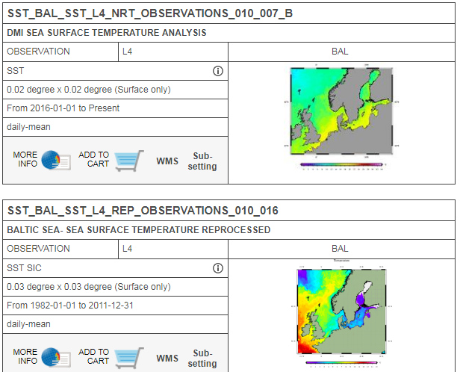
Data
The products identifiers are SST_Bal_sst_L4_rep_observations_010_016 for years 1982-2011 and SST_Bal_sst_L4_nrt_ observations_010_007_b for years 2011-2018 for the Baltic Sea [3].
The Black Sea data used in the work are SST_BS_sst_L4_rep_observations_010_022_a for the years 1982-2017 and SST_BS_sst_L4_nrt_observations_010_006_a_V2 for 2018 [4, 5].
[3] J. L. Hoyer, J. She “Optimal interpolation of sea surface temperature for the North Sea and Baltic Sea”, J. Mar. Sys., 65, 1-4, 176-189, (2007).
[4] B.B. Nardelli, A. Pisano, C. Tronconi, R. Santoleri “Evaluation of different covariance models for the operational interpolation of high resolution satellite Sea Surface Temperature data over the Mediterranean Sea”, Remote Sensing of Environment, 164, 334-343, (2015).
[5] A. Pisano, B.B. Nardelli, C. Tronconi, R. Santoleri “The new Mediterranean optimally interpolated pathfinder AVHRR SST Dataset (1982-2012)”, Remote Sensing of Environment, 176, 107-116, (2016).

Slide 9
Data analysis
To analyze sea temperature data a simple linear regression was carried out. Linear trend estimation is a statistical technique to aid interpretation of data. When measurements are presented as time series, trend estimation can be used to make and justify statements about tendencies in the data. The linear trend line is represented by a linear function of time minimally deviating from the observed values i.e.
To calculate the trend line, in this work the values ​​of the sea surface temperature were averaged over the entire water area, after which the values ​​were averaged over the year to calculate the interannual variability.

Slide 10
Data analysis
The data analysis clearly represents a positive trend in changing of the sea surface temperature values for the Black and Baltic Seas. The graph of the changing surface temperature, averaged over the sea, is presented in Figure: (a) for the Baltic Sea and (b) for the Black Sea water area.
(a)
(b)
Baltic (a) and Black (b) SST for 1982-2018 years, linear trend is indicated by the dotted line, ˚С.

Slide 11
Data analysis
The data analysis clearly represents a positive trend in changing of the sea surface temperature values for the Black and Baltic Seas. The graph of the changing surface temperature, averaged over the year, is presented in Figure
(a)
(b)
Temporal variability of average annual values of the Baltic (a) and Black (b) SST for 1982 – 2018, linear trend is indicated by the dotted line, ˚С.

Slide 12
Data analysis. Baltic Sea
The data analysis clearly represents a positive trend in changing of the sea surface temperature values for the Black and Baltic Seas.
(a)
The trend in changing of the Baltic SST is positive, sea surface temperature rises with change rate +0.044 ±0.008 °C/year, where ±0.008 is dispersion.
To assess the statistical significance of the result obtained, a t-test was carried out, showed significant evidence (p-value < 0.001) against the Null-hypothesis that there is no positive trend, therefore it is reasonable to conclude that average temperature does increase over time.

Slide 13
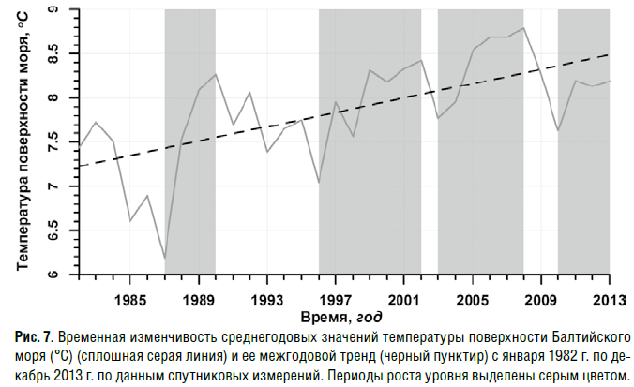
Data analysis. Baltic Sea
The data analysis clearly represents a positive trend in changing of the sea surface temperature values for the Black and Baltic Seas.
(a)
The trend in changing of the Baltic SST is positive, sea surface temperature rises with change rate +0.044 ±0.008 °C/year, where ±0.008 is dispersion.
The result confirms the results of a similar study [6] conducted in 2014. The mentioned work on studying the climatic variability of SST and the level of the Baltic Sea showed that the average surface temperature of the Baltic Sea grew at a rate of +0.04 ±0.02 °C/year during the period 1982-2013.
[6] Lebedev S A 2014 Climatic changes in surface temperature and the level of the Baltic Sea according to remote sensing data Amber Bridge. Journal of Regional Studies 1 (1) pp 78–95. (in Russian)

Slide 14
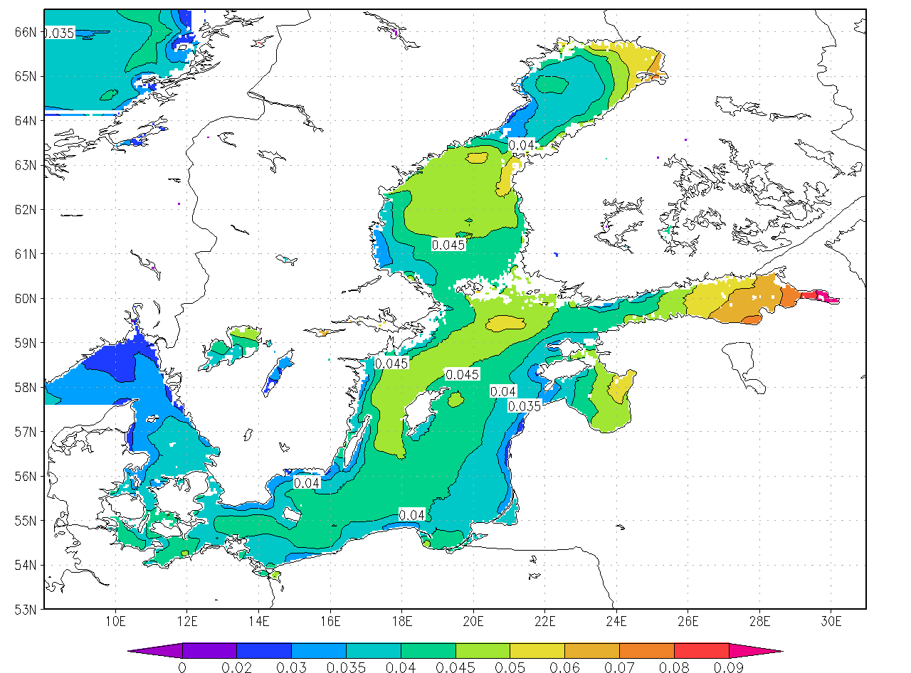
Data analysis. Baltic Sea
Another problem addressed by this research is the study of spatial temperature variability. This refers to the changing of the sea heating over time at each point of the considered area since the change in temperature values in the sea is not uniform.
(a) (b)
Fig. Change rate of the average annual values of the Baltic (a) and Black (b) SST for 1982 – 2018, linear trend is calculated in every point, °C/year.

Slide 15
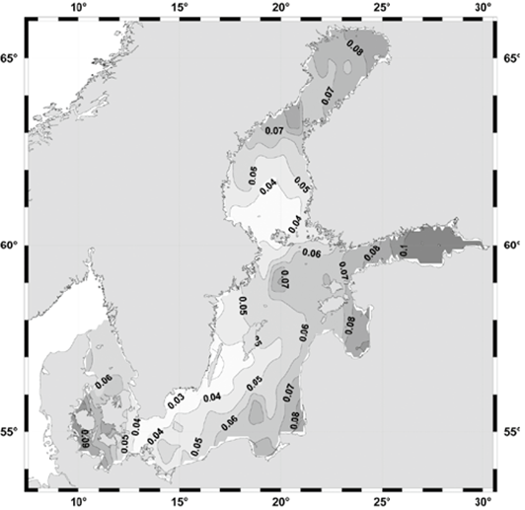
Data analysis. Baltic Sea
In the paper [6] the Gulf of Finland area has been identified as the region with the highest average SST growth rate for the years 1982 - 2013, which is +0.09 ±0.02°C/year. The analysis of observation data for 1982-2018 described in the present study illustrates that the average growth rate of SST in the Gulf of Finland is no longer so high, about +0.06 °C/year.
(a) (b)
Fig. Change rate of the average annual values of the Baltic SST for 1982 – 2018 (a) and for 1982-2013 (b) made in [6], linear trend is calculated in every point, °C/year.
[6] Lebedev S A 2014 Climatic changes in surface temperature and the level of the Baltic Sea according to remote sensing data Amber Bridge. Journal of Regional Studies 1 (1) pp 78–95. (in Russian)

Slide 16
Data analysis. Baltic Sea
In the paper [6] the Gulf of Finland area has been identified as the region with the highest average SST growth rate for the years 1982 - 2013, which is +0.09 ±0.02°C/year. The analysis of observation data for 1982-2018 described in the present study illustrates that the average growth rate of SST in the Gulf of Finland is no longer so high, about +0.06 °C/year.
(a) (b)
Fig. Change rate of the average annual values of the Baltic SST for 1982 – 2018 (a) and for 1982-2013 (b) made in [6], linear trend is calculated in every point, °C/year.
[6] Lebedev S A 2014 Climatic changes in surface temperature and the level of the Baltic Sea according to remote sensing data Amber Bridge. Journal of Regional Studies 1 (1) pp 78–95. (in Russian)

Slide 17
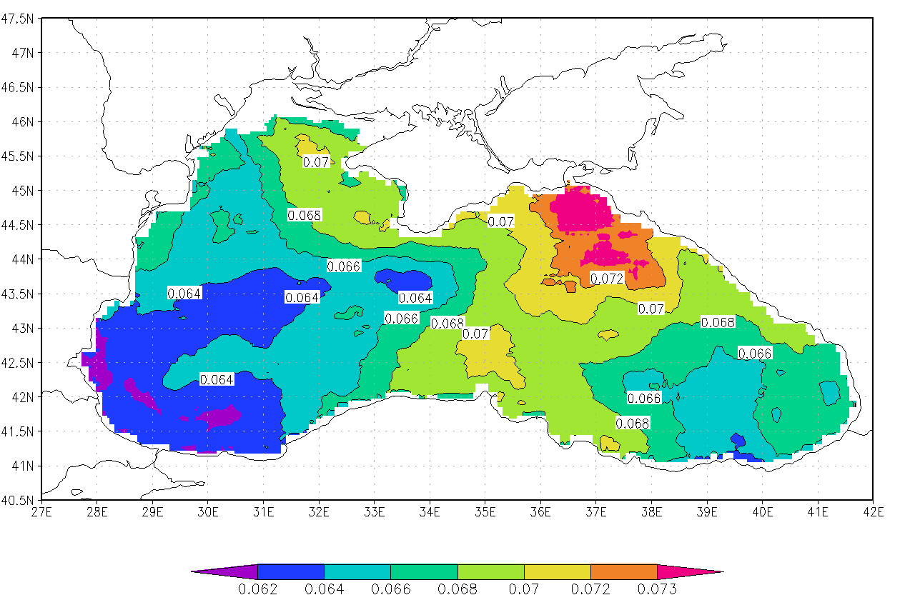
Data analysis. Black Sea
The study of the spatial-temporal variability of the Black Sea surface temperature has also been carried out in the present research. Figure shows the change rate of the sea surface temperature, calculated over 1982–2018 for each point of the Black Sea.
.
Fig. Change rate of the average annual values of the Black SST for 1982 – 2018, linear trend is calculated in every point, °C/year.

Slide 18
Data analysis. Black Sea
The Black SST data analysis also revealed a positive trend, the surface temperature increase with the speed +0.066 ±0.007°C/year during the period 1982-2018 (Figure 2b).
Fig. Temporal variability of average annual values of the Black SST for 1982 – 2018, linear trend is indicated by the dotted line, ˚С.
.

Slide 19

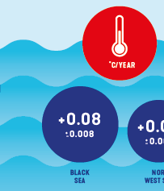


Data analysis. Black Sea
The Black SST data analysis also revealed a positive trend, the surface temperature increase with the speed +0.066 ±0.007°C/year during the period 1982-2018 (Figure 2b).
Fig. Temporal variability of average annual values of the Black SST for 1982 – 2018, linear trend is indicated by the dotted line, ˚С.
.
According to Copernicus Marine Service Ocean State Report [7], global sea surface temperature has increased and SST trend is +0.08 ±0.008 °C/year for the Black Sea water area and +0.03 ±0.007 °C/year for the Baltic Sea (based on data for the period 1993-2016 years).
[7] Von Schuckmann K, Le Traon P Y, Smith N, Pascual A, Brasseur P, Fennel K and Djavidnia S 2018 Copernicus Marine Service Ocean State Report 2, Journal of Operational Oceanography, 11:sup1, s1–s142.

Slide 20
Conclusion
The use of modern technologies allows one to efficiently process and analyze data.
In the research the data on the sea surface temperature for 1982–2018 years were processed for two water areas: the Black Sea and the Baltic Sea. Data analysis revealed a positive trend in changes in the average annual values of SST in the both seas.
The study of spatial and temporal variability allows to identify areas with the highest rate of temperature change and to analyze the changes in certain parts of the water areas.
Financial assistance by the grant of the president of the Russian Federation №МК-3228.2018.5 is acknowledged.

Slide 21
Conclusion
The use of modern technologies allows one to efficiently process and analyze data.
Python -> data processing R -> data analysis
In the research the data on the sea surface temperature for 1982–2018 years were processed for two water areas: the Black Sea and the Baltic Sea. Data analysis revealed a positive trend in changes in the average annual values of SST in the both seas.
The study of spatial and temporal variability allows to identify areas with the highest rate of temperature change and to analyze the changes in certain parts of the water areas.
Financial assistance by the grant of the president of the Russian Federation №МК-3228.2018.5 is acknowledged.

Slide 22
Conclusion
The use of modern technologies allows one to efficiently process and analyze data.
Python -> data processing R -> data analysis
In the research the data on the sea surface temperature for 1982–2018 years were processed for two water areas: the Black Sea and the Baltic Sea. Data analysis revealed a positive trend in changes in the average annual values of SST in the both seas.
Black SST -> +0.066 ±0.007 °C/year Baltic Sea -> +0.044 ±0.008 °C/year.
The study of spatial and temporal variability allows to identify areas with the highest rate of temperature change and to analyze the changes in certain parts of the water areas.
Financial assistance by the grant of the president of the Russian Federation №МК-3228.2018.5 is acknowledged.

Slide 23
Conclusion
The use of modern technologies allows one to efficiently process and analyze data.
Python -> data processing R -> data analysis
In the research the data on the sea surface temperature for 1982–2018 years were processed for two water areas: the Black Sea and the Baltic Sea. Data analysis revealed a positive trend in changes in the average annual values of SST in the both seas.
Black SST -> +0.066 ±0.007 °C/year Baltic Sea -> +0.044 ±0.008 °C/year.
The study of spatial and temporal variability allows to identify areas with the highest rate of temperature change and to analyze the changes in certain parts of the water areas.
The positive trend (revealed earlier) for the whole sea is being preserved. However, for the Gulf of Finland, the average change rate decreased from +0.09 °C/year to +0.06 °C/year.
Financial assistance by the grant of the president of the Russian Federation №МК-3228.2018.5 is acknowledged.

Slide 24
Thank you for the attention

