Slide 1
Outline
Theoretical Lectures (~ 2.5 hours)
Probability & Statistical distributions (~50 mins)
Hypothesis test (~ 50 mins)
Linear regression model (~ 50 mins)
---- break--------------------------
Practices (~ 1.5 hours)
Using R

Slide 2
Trump’s 2,000 Lies – A Documentary

Slide 3
Trump’s 2,000 Lies – A Documentary

Slide 4
Outline:
1 Null and Alternative Hypotheses
2 Test Statistic
3 P-Value
4 Significance Level
5 One-Sample z Test
6 Power and Sample Size

Slide 5
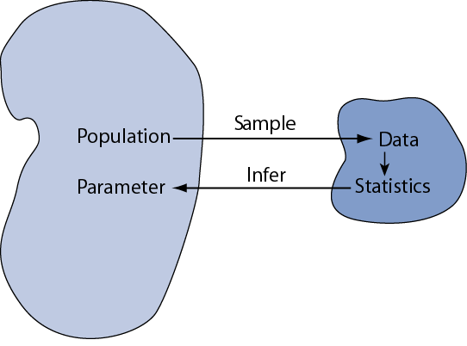
Some Terms
Population ≡ all possible values
Sample ≡ a portion of the population
Statistical inference ≡ generalizing from a sample to a population with calculated degree of certainty
Notes:
Hypothesis testing is one of the two common forms of statistical inference. This slide reviews some of the terms that form the basis of statistical inference, as introduced in the prior chapter. Make certain you understand these basics before proceeding.

Slide 6
Some Terms
Population ≡ all possible values
Sample ≡ a portion of the population
Statistical inference ≡ generalizing from a sample to a population with calculated degree of certainty
Two forms of statistical inference
Hypothesis testing
Estimation
Parameter ≡ a characteristic of population, e.g., population mean µ
Statistic ≡ calculated from data in the sample, e.g., sample mean
Notes:
Hypothesis testing is one of the two common forms of statistical inference. This slide reviews some of the terms that form the basis of statistical inference, as introduced in the prior chapter. Make certain you understand these basics before proceeding.

Slide 7
Distinctions Between Parameters and Statistics
 | Parameters | Statistics
Source | Population | Sample
Notation | Greek (e.g., μ) | Roman (e.g., )
Vary | No | Yes
Calculated | No | Yes
Notes:
This slide address an other foundation of statistical inference: the difference between parameters and statistics. Parameters and statistics are related, but are not the same thing.
Over the years teaching statistics, I have derived a hypothesis that explains why some students have difficulty with statistical inference: they fail to distinguish between statistics and parameter. When a student calculates a statistic such as a sample mean, it seems so tangible and real that they view it as a constant. I think they would be better off if they recognized a statistic as merely one example of what might have been had they done the study or experiment at a different time.

Slide 8
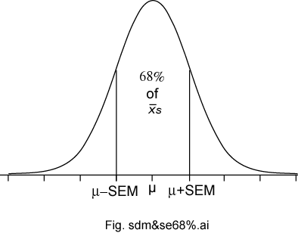
Sampling Distributions of a Mean
The sampling distributions of a mean (SDM) describes the behavior of a sampling mean
Notes:
This slide summarize what we’ve learned about the sampling distribution of a mean from a large sample. It is based no three important sampling postulates: the central limit theorem, the law of large numbers (unbiased nature of the sample mean), and square root law. Based on these well established statistical theorems we can say that means based on large samples (and means based in Normal populations) will have a Normal sampling distribution with an expectation equal to the population mean with a standard deviation equal to the standard deviation of the population divided by the square root of the sample size n.

Slide 9
Hypothesis Testing
Is also called significance testing
Tests a claim about a parameter using evidence (data in a sample)
The technique is introduced by considering a one-sample z test
The procedure is broken into four steps
Each element of the procedure must be understood
Notes:
Hypothesis testing (also called significance testing) uses a quasi-deductive procedure to judge claims about parameters. Before testing a statistical hypothesis it is important to clearly state the nature of the claim to be tested. We are then going to use a four step procedure (as outlined in the last bullet) to test the claim.

Slide 10
Hypothesis Testing Steps
Null and alternative hypotheses
Test statistic
P-value and interpretation
Significance level

Slide 11
§1 Null and Alternative Hypotheses
Convert the research question to null and alternative hypotheses
The null hypothesis (H₀) is a claim of “no difference in the population” (e.g. wearing mask is not helpful to prevent COVID-19)
The alternative hypothesis (H_{a}) claims “H₀ is false”
Collect data and seek evidence against H₀ as a way of bolstering H_{a}
Notes:
The first step in the procedure is to state the hypotheses null and alternative forms. The null hypothesis (abbreviate “H naught”) is a statement of no difference. The alternative hypothesis (“H sub a”) is a statement of difference. Seek evidence against the claim of H₀ as a way of bolstering H_{a.}
The next slide offers an illustrative example on setting up the hypotheses.

Slide 12
Illustrative Example: “Body Weight”
The problem: In the 1970s, 20–29 year old men in the U.S. had a mean μ body weight of 170 pounds. Standard deviation σ was 40 pounds. We test whether mean body weight in the population now differs.
Null hypothesis H_{0:} μ = 170 (“no difference”)
The alternative hypothesis can be either H_{a:} μ > 170 (one-sided test) or H_{a:} μ ≠ 170 (two-sided test)
Notes:
In the late 1970s, the weight of U.S. men between 20- and 29-years of age had a log-normal distribution with a mean of 170 pounds and standard deviation of 40 pounds. As you know, the overweight and obese conditions seems to be more prevalent today, constituting a major public health problem. To illustrate the hypothesis testing procedure, we ask if body weight in this group has increased since 1970. Under the null hypothesis there is no difference in the mean body weight between then and now, in which case μ would still equal 170 pounds.
Under the alternative hypothesis, the mean weight has increased Therefore, H_{a:} μ > 170. This statement of the alternative hypothesis is one-sided. That is, it looks only for values larger than stated under the null hypothesis.
There is another way to state the alternative hypothesis. We could state it in a “two-sided” manner, looking for values that are either higher- or lower-than expected. For the current illustrative example, the two-sided alternative is H_{a:} μ ≠ 170. Although for the current illustrative example, this seems unnecessary, two-sided alternative offers several advantages and are much more common in practice.

Slide 13
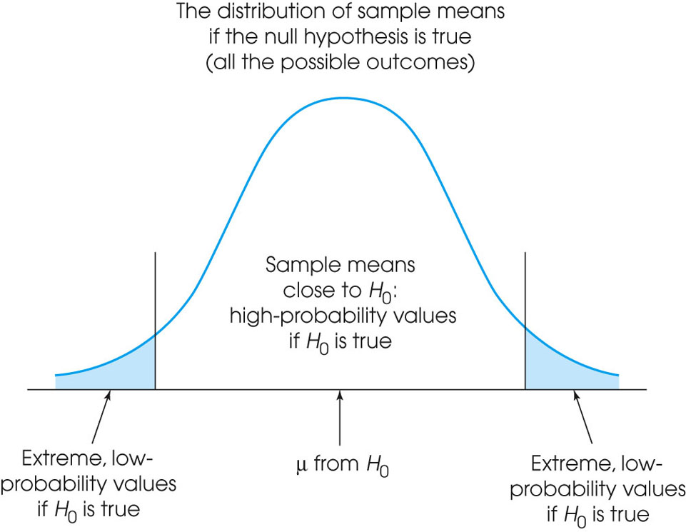
Notes:
Figure 8.3
The set of potential samples is divided into those that are likely to be obtained and those that are very unlikely to be obtained if the null hypothesis is true.

Slide 14
§2 Test Statistic
This is an example of a one-sample test of a mean when σ is known. Use this statistic to test the problem:

Slide 15
Illustrative Example: z statistic
For the illustrative example, μ₀ = 170
We know σ = 40
Take an sample size of n = 64. Therefore
If we found a sample mean $\bar{x}$ of 173, then
$$z_{\text{stat}}= \frac{\bar{x}−μ_{0}}{SE_{\bar{x}}}=\frac{173−170}{5}=0.60$$

Slide 16
Illustrative Example: z statistic
If we found a sample mean $\bar{x}$ of 185, then

Slide 17
Reasoning Behind f($\bar{x}$)
Sampling distribution of $\bar{x}$ under H₀: µ = 170 for n = 64 ⇒

Slide 18
§3 P-value
The P-value answer the question: What is the probability of the observed test statistic to be extreme when H₀ is true?
This corresponds to the areas under curve (AUC) in the tail of the Standard Normal distribution beyond the z_{stat.}
Convert z statistics to P-value :
For H_{a}: μ > μ₀ ⇒ P = Pr(Z > z_{stat}) = right-tail beyond z_{stat}
For H_{a}: μ < μ₀ ⇒ P = Pr(Z < z_{stat}) = left tail beyond z_{stat}
For H_{a}: μ ≠ μ₀ ⇒ P = 2 × one-tailed P-value
Use Test Table or software to find these probabilities.

Slide 19
One-sided P-value for z_{stat} of 0.6

Slide 20
One-sided P-value for z_{stat} of 3.0

Slide 21
Two-Sided P-Value
One-sided H_{a} ⇒ AUC in tail beyond z_{stat}
Two-sided H_{a} ⇒ consider potential deviations in both directions ⇒ double the one-sided P-value
Examples: If one-sided P = 0.0010, then two-sided P = 2 × 0.0010 = 0.0020. If one-sided P = 0.2743, then two-sided P = 2 × 0.2743 = 0.5486.

Slide 22
Interpretation
P-value answer the question: What is the probability of the observed test statistic … when H₀ is true?
Thus, smaller and smaller P-values provide stronger and stronger evidence against H₀
Small P-value ⇒ strong evidence

Slide 23
Interpretation
Conventions*
P > 0.10 ⇒ non-significant evidence against H₀
0.05 < P ≤ 0.10 ⇒ marginally significant evidence
0.01 < P ≤ 0.05 ⇒ significant evidence against H₀
P ≤ 0.01 ⇒ highly significant evidence against H₀
Examples
P =.27 ⇒ non-significant evidence against H₀
P =.01 ⇒ highly significant evidence against H₀
* It is unwise to draw firm borders for “significance”

Slide 24
§4 α-Level (Used in some situations)
Let α ≡ probability of erroneously rejecting H₀
Set α threshold (e.g., let α = .10, .05, or whatever)
Reject H₀ when P ≤ α
Retain H₀ when P > α
Example: Set α = .10. Find P = 0.27 ⇒ retain H₀
Example: Set α = .01. Find P = .001 ⇒ reject H₀

Slide 25
(Summary) One-Sample z Test
Hypothesis statements H₀: µ = µ₀ vs. H_{a}: µ ≠ µ₀ (two-sided) or H_{a}: µ < µ₀ (left-sided) or H_{a}: µ > µ₀ (right-sided)
Test statistic
P-value: convert z_{stat} to P value
Significance statement

Slide 26
§5 Conditions for z test
σ known (not from data)
Population approximately Normal or large sample (central limit theorem)
If not, check out student t-test.

Slide 27
The Lake Wobegon Example “where all the children are above average”
Let X represent Weschler Adult Intelligence scores (WAIS)
Typically, X ~ N(100, 15)
Take a random sample of n = 9 from Lake Wobegon population
Data ⇒ {116, 128, 125, 119, 89, 99, 105, 116, 118}
Calculate: $\bar{x}$= 112.8
Does sample mean provide strong evidence that population mean μ > 100?

Slide 28
Example: “Lake Wobegon”
Hypotheses: H₀: µ = 100 versus H_{a}: µ > 100 (one-sided) H_{a}: µ ≠ 100 (two-sided)
Test statistic:

Slide 29
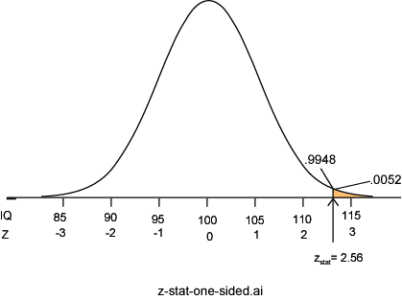
C. P-value: P = Pr(Z ≥ 2.56) = 0.0052
P =.0052 ⇒ it is unlikely the sample came from this null distribution ⇒ strong evidence against H₀

Slide 30
Two-Sided P-value: Lake Wobegon
H_{a}: µ ≠100
Considers random deviations “up” and “down” from μ₀ ⇒tails above and below ±z_{stat}
Thus, two-sided P = 2 × 0.0052 = 0.0104

Slide 31
§6 Power and Sample Size
Two types of decision errors:
Type I error = erroneous rejection of true H₀
Type II error = erroneous retention of false H₀
 | Truth
Decision | H₀ true | H₀ false
Retain H₀ | Correct retention | Type II error
Reject H₀ | Type I error | Correct rejection
α ≡ probability of a Type I error
β ≡ Probability of a Type II error

Slide 32
Power
β ≡ probability of a Type II error
β = Pr(retain H₀ | H₀ false) (the “|” is read as “given”)
1 – β = “Power” ≡ probability of avoiding a Type II error 1– β = Pr(reject H₀ | H₀ false)

Slide 33
Power of a z test
$$1−β=Φ\left(−z_{1−\frac{α}{2}}+\frac{|μ_{0}−μ_{a}|\sqrt{n}}{σ}\right)$$
where
Φ(z) represent the cumulative probability of Standard Normal Z
μ₀ represent the population mean under the null hypothesis
μ_{a} represents the population mean under the alternative hypothesis

Slide 34
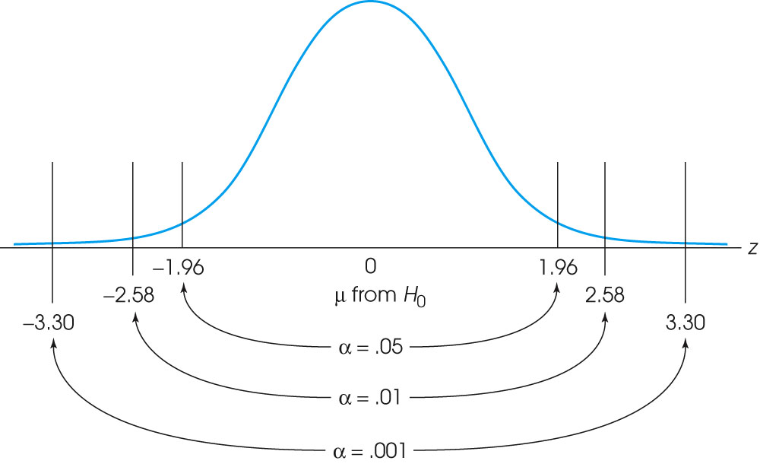
$$z_{1−\frac{α}{2}}$$
Notes:
Figure 8.5
The locations of the critical region boundaries for three different levels of significance: α = .05, α = .01, and α = .001.

Slide 35
Confidence interval
At this point it is important to note the intimate relation between confidence intervals and hypothesis testing.
In summary, you can always test based on confidence intervals. However, there are some limitations of this approach:
It doesn’t give you a natural way to compute p-values
You won’t be able to plan your experiment and decide how many samples need to be collected to ensure a certain power of your test
It can become awkward in some testing scenarios…

Slide 36
Calculating Power: Example
A study of n = 16 retains H₀: μ = 170 at α = 0.05 (two-sided); σ is 40. What was the power of test’s conditions to identify a population mean of 190?

Slide 37
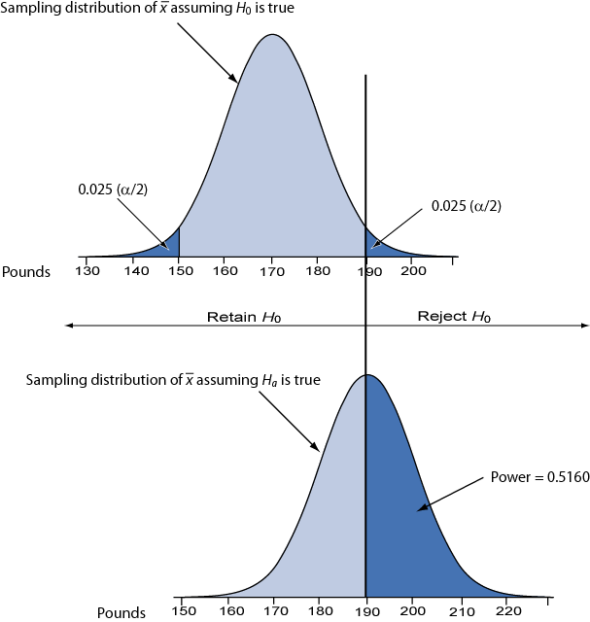
Reasoning Behind Power
Competing sampling distributions
Top curve assumes H₀ is true
Bottom curve assumes H_{a} is true
α is set to 0.05 (two-sided)
We will reject H₀ when a sample mean exceeds 189.6 (right tail, top curve)
The probability of getting a value greater than 189.6 on the bottom curve is 0.5160, corresponding to the power of the test

Slide 38
Sample Size Requirements
Sample size for one-sample z test:
where
1 – β ≡ desired power
α ≡ desired significance level (two-sided)
σ ≡ population standard deviation
Δ = μ₀ – μ_{a} ≡ the difference worth detecting

Slide 39
Example: Sample Size Requirement
How large a sample is needed for a one-sample z test with 90% power and α = 0.05 (two-tailed) when σ = 40? Let H₀: μ = 170 and H_{a}: μ = 190 (thus, Δ = μ₀ − μ_{a} = 170 – 190 = −20)
Round up to 42 to ensure adequate power.

Slide 40
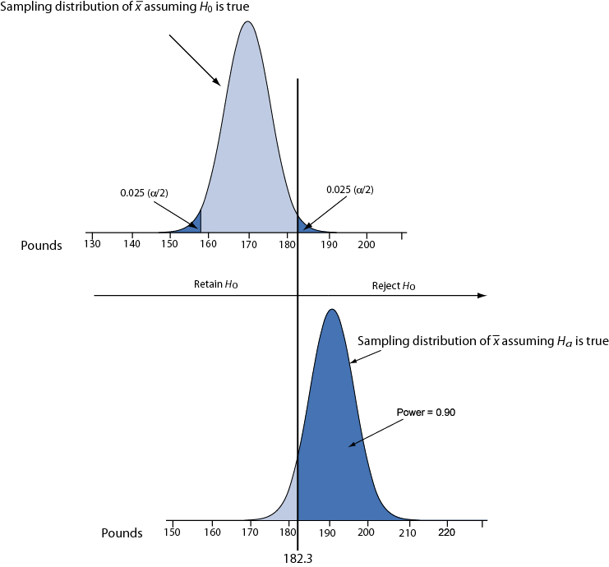
Illustration: conditions for 90% power.

Slide 41
