Slide 1
Applied Statistics Outline
Theoretical Lectures (~ 2.5 hours)
  Probability & Statistical distributions (~50 mins)
  Hypothesis test (~ 50 mins)
  Linear regression model (~ 50 mins)
  ---- break--------------------------
Practices (~ 1.5 hours)
  Using R

Slide 2
Probability & Statistical distributions Outline
Probability and random variables
  Random experiment and random variable
  Probability mass/density functions
  Expectation, variance, covariance, correlation
Probability distributions
  Discrete probability distributions
  Continuous probability distributions

Slide 3
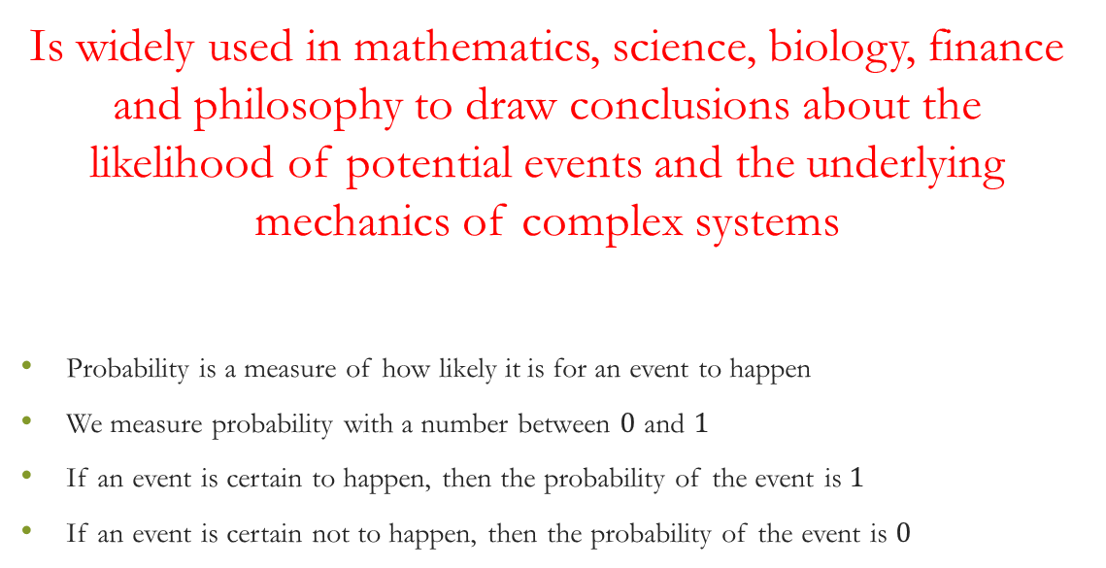
Probability
Is widely used in mathematics, science, biology, finance and philosophy to draw conclusions about the likelihood of potential events and the underlying mechanics of complex systems
Probability is a measure of how likely it is for an event to happen
We measure probability with a number between $0$ and $1$
If an event is certain to happen, then the probability of the event is $1$
If an event is certain not to happen, then the probability of the event is $0$

Slide 4
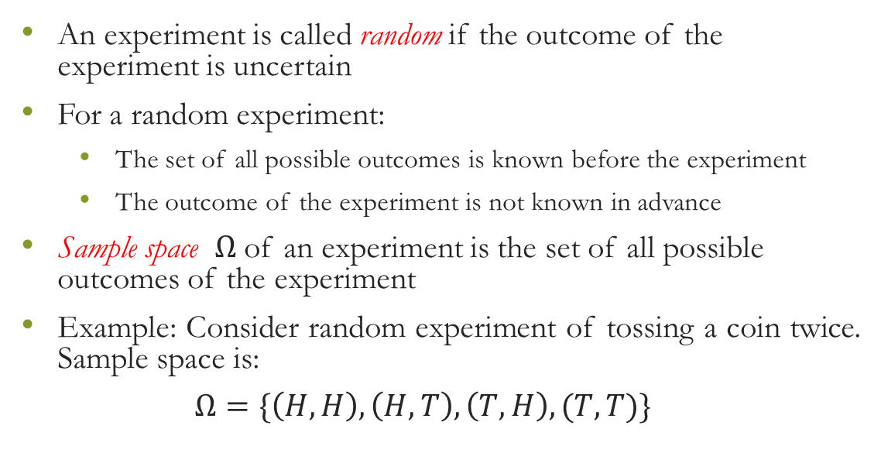
Random Experiment
An experiment is called random if the outcome of the experiment is uncertain
For a random experiment:
  The set of all possible outcomes is known before the experiment
  The outcome of the experiment is not known in advance
Sample space $Ω$ of an experiment is the set of all possible outcomes of the experiment
Example: Consider random experiment of tossing a coin twice. Sample space is:
$$Ω=\{\left(H,H\right), \left(H, T\right), \left(T,H\right), (T,T)\}$$

Slide 5
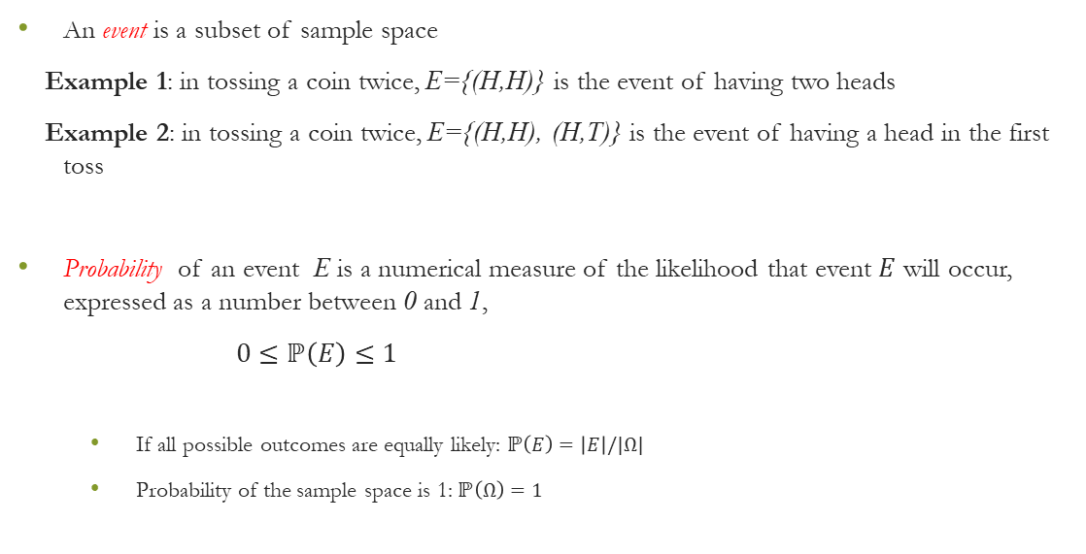
Probability of Events
An event is a subset of sample space
Example 1: in tossing a coin twice, E={(H,H)} is the event of having two heads
Example 2: in tossing a coin twice, E={(H,H), (H,T)} is the event of having a head in the first toss
Probability of an event E is a numerical measure of the likelihood that event $E$ will occur, expressed as a number between 0 and 1,
$0≤ℙ\left(E\right)≤1$
  If all possible outcomes are equally likely: $ℙ\left(E\right)=\left|E\right|/|Ω|$
  Probability of the sample space is 1:$ℙ\left(Ω\right)=1$

Slide 6
Random Variable
A numerical value can be associated with each outcome of an experiment
A random variable X is a function from the sample space Ω to the real line that assigns a real number X(s) to each element s of Ω
X: Ω → R
Random variable takes on its values with some probability

Slide 7
Random Variable
Example: Consider random experiment of tossing a coin twice. Sample space is:
Ω = {(H,H), (H,T), (T,H), (T,T)}
Define random variable X as the number of heads in the experiment:
X((T,T)) = 0, X((H,T))=1,
X((T,H)) = 1, X((H,H))=2
Example: Rolling a die.
Sample space Ω = {1,2,3,4,5,6).
Define random variable X as the number rolled:
X(j) = j, 1 ≤ j ≤ 6

Slide 8
Types of Random Variables
Discrete
  Random variables whose set of possible values can be written as a finite or infinite sequence
  Example: number of requests sent to a web server
Continuous
  Random variables that take a continuum of possible values
  Example: time between requests sent to a web server

Slide 9
Two Types of Random Variables
A discrete random variable can assume a countable number of values.
  Number of steps to the top of the Eiffel Tower*
A continuous random variable can assume any value along a given interval of a number line.
  The time a tourist stays at the top
  once s/he gets there
*Believe it or not, the answer ranges from 1,652 to 1,789. See Great Buildings

Slide 10

Two Types of Random Variables
Discrete random variables
  Number of sales
  Number of calls
  Shares of stock
  People in line
  Mistakes per page
Continuous random variables
  Length
  Depth
  Volume
  Time
  Weight

Slide 11
Random Variable
Example: roll two fair dice and observe the outcome
Sample space = {(i,j) | 1 ≤ i ≤ 6, 1 ≤ j ≤ 6}
i: integer from the first die
j: integer from the second die
(1,1) | (1,2) | (1,3) | (1,4) | (1,5) | (1,6)
(2,1) | (2,2) | (2,3) | (2,4) | (2,5) | (2,6)
(3,1) | (3,2) | (3,3) | (3,4) | (3,5) | (3,6)
(4,1) | (4,2) | (4,3) | (4,4) | (4,5) | (4,6)
(5,1) | (5,2) | (5,3) | (5,4) | (5,5) | (5,6)
(6,1) | (6,2) | (6,3) | (6,4) | (6,5) | (6,6)
Possible outcomes

Slide 12
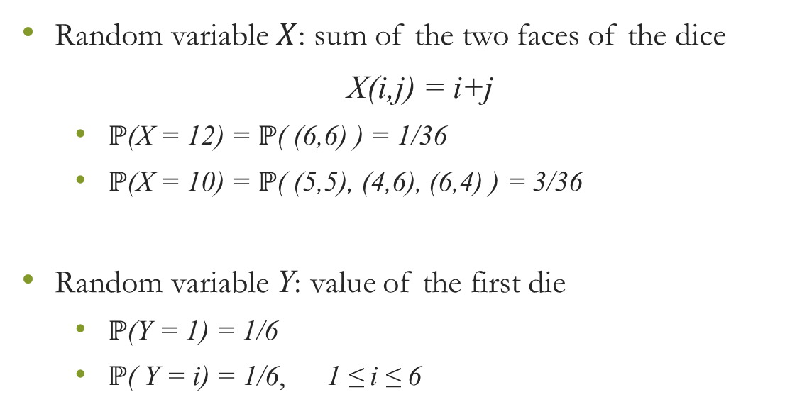
Random Variable
Random variable $X$: sum of the two faces of the dice
X(i,j) = i+j
  $ℙ$(X = 12) = $ℙ$( (6,6) ) = 1/36
  $ℙ$(X = 10) = $ℙ$( (5,5), (4,6), (6,4) ) = 3/36
Random variable Y: value of the first die
  $ℙ$(Y = 1) = 1/6
  $ℙ$( Y = i) = 1/6, 1 ≤ i ≤ 6

Slide 13

Probability Mass Function (PMF)
X: discrete random variable
$p(x_{i})$: probability mass function of $X$, where
$p\left(x_{i}\right)=ℙ⁡(X=x_{i})$
Properties:
  $$0≤p\left(x_{i}\right)≤1$$
  $$\sum_{x_{i}}{p(x_{i})}=1$$

Slide 14
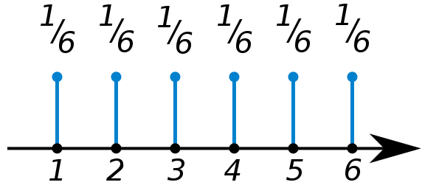
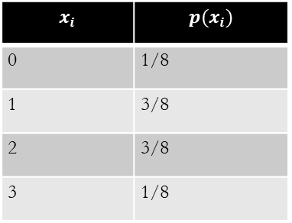
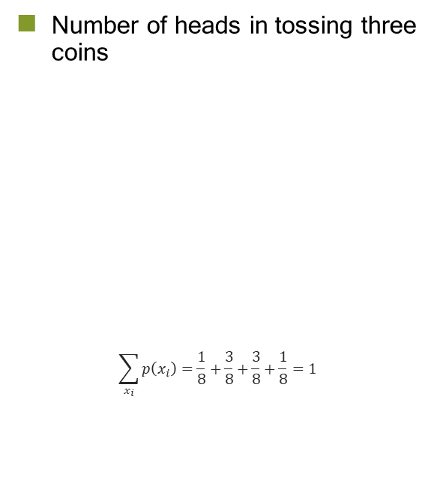

PMF Examples
Number of heads in tossing three coins
$$\sum_{x_{i}}{p\left(x_{i}\right)=\frac{1}{8}+\frac{3}{8}+\frac{3}{8}+\frac{1}{8}=1}$$
Number rolled in rolling a fair die
$$\sum_{x_{i}}{p\left(x_{i}\right)=\frac{1}{6}+\frac{1}{6}+\frac{1}{6}+\frac{1}{6}+\frac{1}{6}+\frac{1}{6}=1}$$
$$x_{i}$$ | $$p(x_{i})$$
0 | 1/8
1 | 3/8
2 | 3/8
3 | 1/8

Slide 15
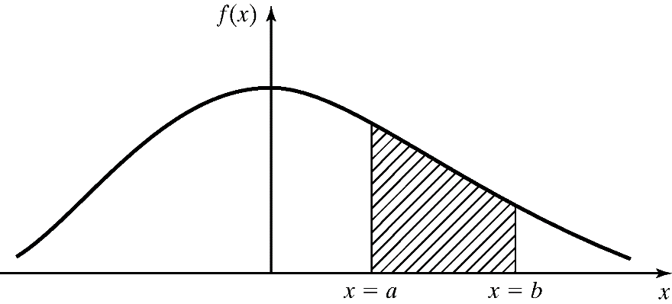

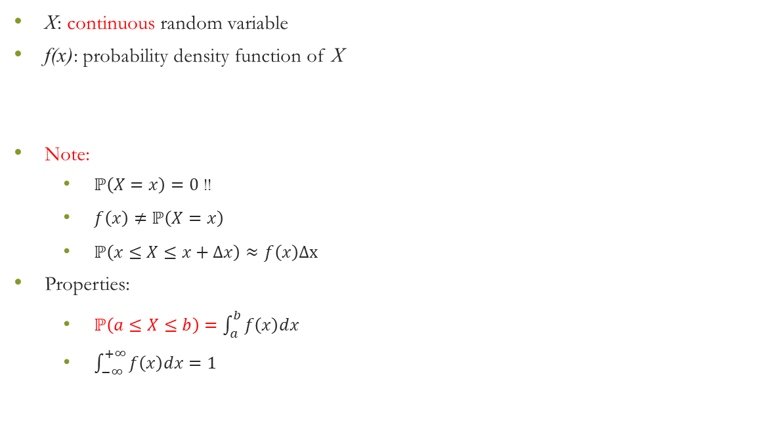
Probability Density Function (PDF)
X: continuous random variable
f(x): probability density function of X
Note:
  $ℙ\left(X=x\right)=0$ !!
  $f\left(x\right)≠ℙ\left(X=x\right)$
  $ℙ\left(x≤X≤x+Δx\right)≈f\left(x\right)Δx$
Properties:
  $ℙ\left(a≤X≤b\right)=\int_{a}^{b}{f\left(x\right)dx}$
  $\int_{−∞}^{+∞}{f\left(x\right)dx}=1$
CDF of $X$

Slide 16
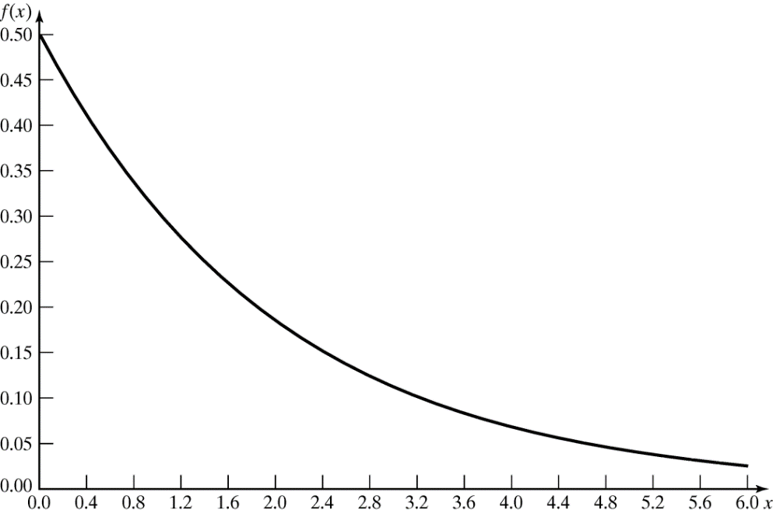

Probability Density Function
Example: Life of an inspection device is given by $X$, a continuous random variable with PDF:
$f\left(x\right)=\frac{1}{2}e^{−\frac{x}{2}}$, for $x≥0$
  $X$ has an exponential distribution with mean 2 years
  Probability that the device’s life is between 2 and 3 years:
  $$ℙ\left(2≤X≤3\right)=\frac{1}{2}\int_{2}^{3}{e^{−\frac{x}{2}}dx=0.14}$$

Slide 17
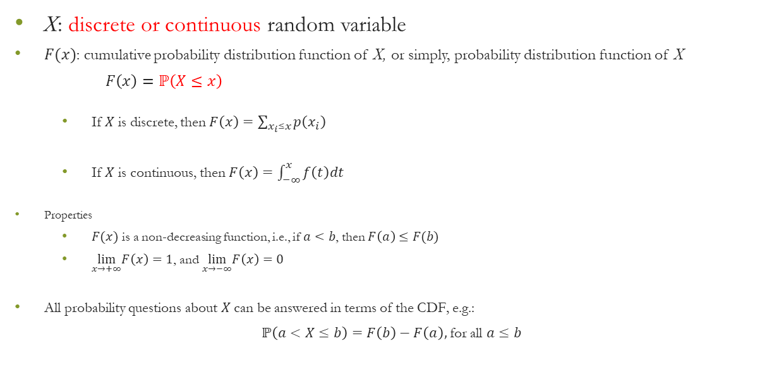
Cumulative Distribution Function (CDF)
X: discrete or continuous random variable
$F(x)$: cumulative probability distribution function of X, or simply, probability distribution function of X
$F\left(x\right)=ℙ\left(X≤x\right)$
  If $X$ is discrete, then $F\left(x\right)=\sum_{x_{i}≤x}{p\left(x_{i}\right)}$
  If $X$ is continuous, then $F\left(x\right)=\int_{−∞}^{x}{f\left(t\right)dt }$
Properties
  $F(x)$ is a non-decreasing function, i.e., if $a<b$, then $F\left(a\right)≤F(b)$
  $\lim_{x→+∞}F\left(x\right)=1$, and$\lim_{x→−∞}F\left(x\right)=0$
All probability questions about $X$ can be answered in terms of the CDF, e.g.:
$ℙ\left(a<X≤b\right)=F\left(b\right)−F\left(a\right),$ for all $a≤b$

Slide 18

Expectation of a Random Variable
Mean or Expected Value:
Example: number of heads in tossing three coins
E[X] = 0 $⋅$p(0) + 1 $⋅$p(1) + 2 $⋅$p(2) + 3 $⋅$p(3)
= 1 $⋅$3/8 + 2 $⋅$3/8 + 3 $⋅$1/8
= 12/8
= 1.5

Slide 19
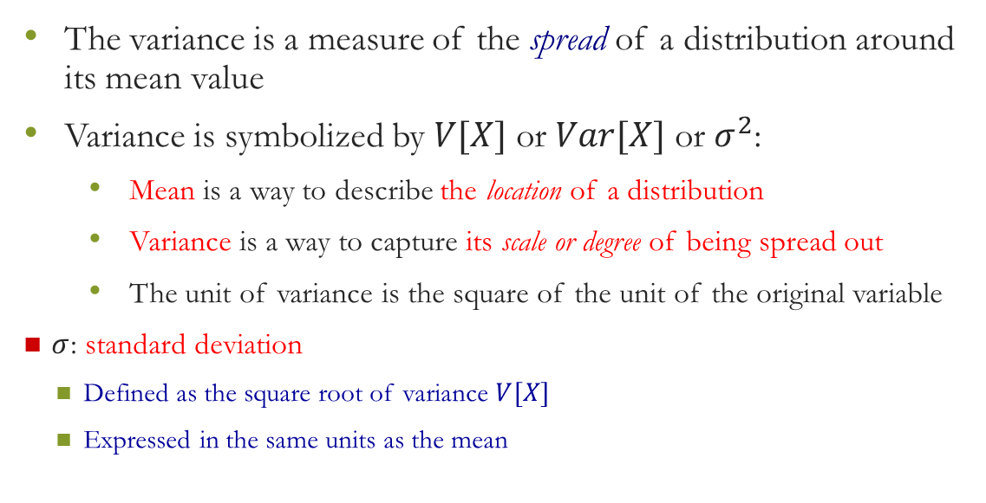
Variance of a Random Variable
The variance is a measure of the spread of a distribution around its mean value
Variance is symbolized by $V[X]$ or $Var[X]$ or $σ^{2}$:
  Mean is a way to describe the location of a distribution
  Variance is a way to capture its scale or degree of being spread out
  The unit of variance is the square of the unit of the original variable
  $σ$: standard deviation
    Defined as the square root of variance $V[X]$
    Expressed in the same units as the mean

Slide 20
Variance of a Random Variable
Variance: The expected value of the square of distance between a random variable and its mean
where, μ= E[X]
Equivalently:
σ² = E[X²] – (E[X])²

Slide 21
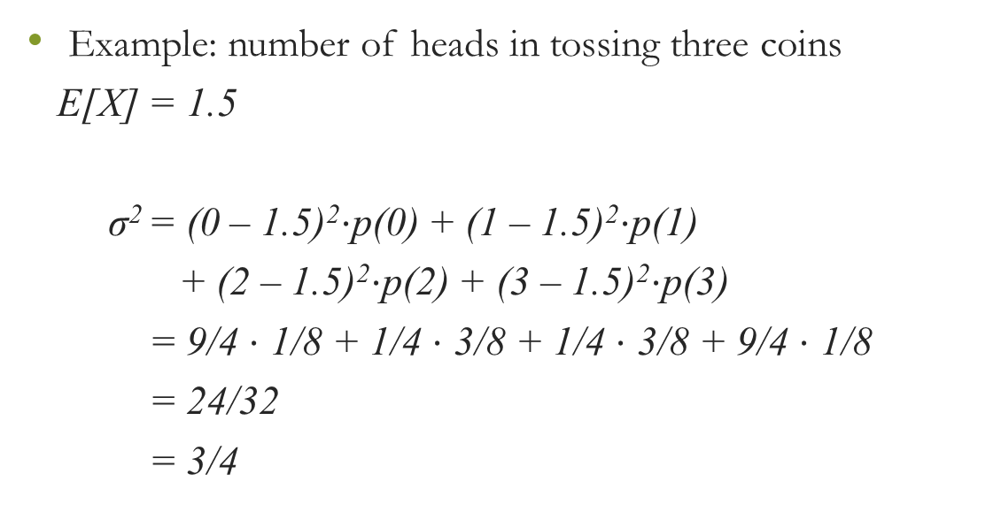
Variance of a Random Variable
Example: number of heads in tossing three coins
E[X] = 1.5
σ² = (0 – 1.5)²$⋅$p(0) + (1 – 1.5)²$⋅$p(1)
+ (2 – 1.5)²$⋅$p(2) + (3 – 1.5)²$⋅$p(3)
= 9/4 $⋅$ 1/8 + 1/4 $⋅$ 3/8 + 1/4 $⋅$ 3/8 + 9/4 $⋅$ 1/8
= 24/32
= 3/4

Slide 22
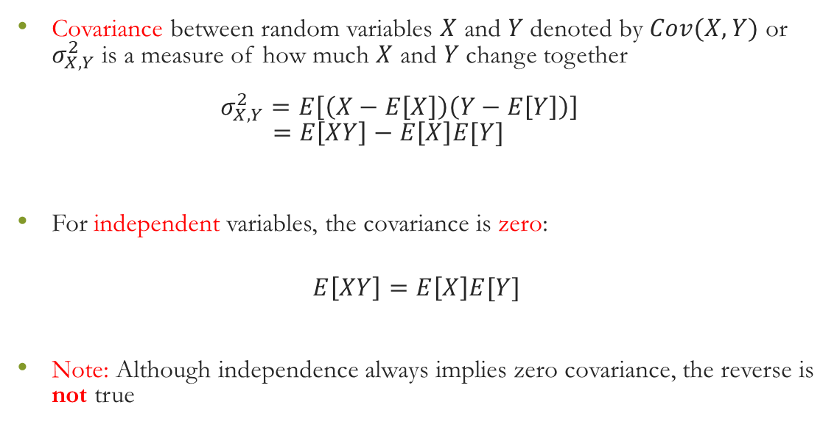
Covariance
Covariance between random variables $X$ and $Y$ denoted by $Cov(X,Y)$ or $σ_{X,Y}^{2}$ is a measure of how much $X$ and $Y$ change together
$σ_{X,Y}^{2}=E\left[\left(X−E\left[X\right]\right)\left(Y−E\left[Y\right]\right)\right]$
$=E\left[XY\right]−E\left[X\right]E[Y]$
For independent variables, the covariance is zero:
$$E\left[XY\right]=E\left[X\right]E[Y]$$
Note: Although independence always implies zero covariance, the reverse is not true

Slide 23

Covariance
Example: tossing three coins
  X: number of heads
  Y: number of tails
  E[X] = E[Y] = 3/2
E[XY]?
  X and Y depend on each other
  Y = 3 – X
  E[XY] = 0×P(0) + 2×P(2)
  = 3/2
$σ_{X,Y}^{2}$= E[XY] – E[X]E[Y]
= 3/2 – 3/2 × 3/2
= – 3/4
x | y | xy | p(x)
0 | 3 | 0 | 1/8
1 | 2 | 2 | 3/8
2 | 1 | 2 | 3/8
3 | 0 | 0 | 1/8
xy | p(xy)
0 | 2/8
2 | 6/8

Slide 24
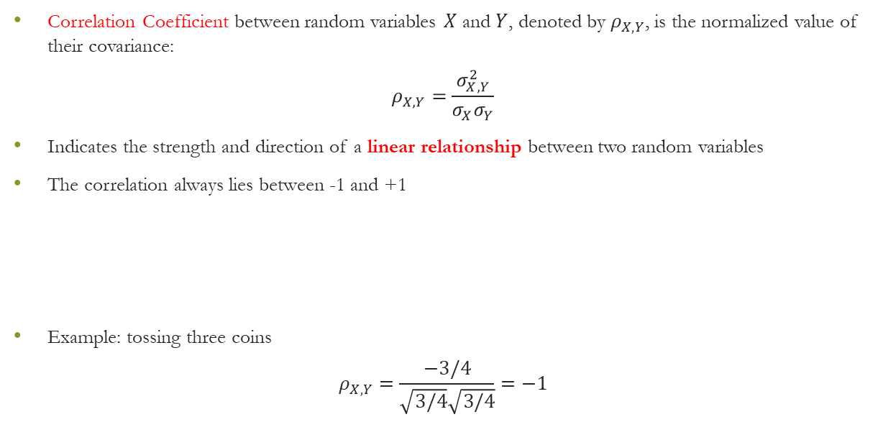
Correlation
Correlation Coefficient between random variables $X$ and $Y$, denoted by $ρ_{X,Y}$, is the normalized value of their covariance:
$$ρ_{X,Y}=\frac{σ_{X,Y}^{2}}{σ_{X}σ_{Y}}$$
Indicates the strength and direction of a linear relationship between two random variables
The correlation always lies between -1 and +1
Example: tossing three coins
$$ρ_{X,Y}=\frac{−3/4}{\sqrt{3/4}\sqrt{3/4}}=−1$$
Negative linear
correlation
Positive linear
correlation
No correlation
-1
0
+1

Slide 25
Probability & Statistical distributions Outline
Probability and random variables
  Random experiment and random variable
  Probability mass/density functions
  Expectation, variance, covariance, correlation
Probability distributions
  Discrete probability distributions
  Continuous probability distributions

Slide 26
Outline
Probability and random variables
  Random experiment and random variable
  Probability mass/density functions
  Expectation, variance, covariance, correlation
Probability distributions
  Discrete probability distributions
  Continuous probability distributions

Slide 27



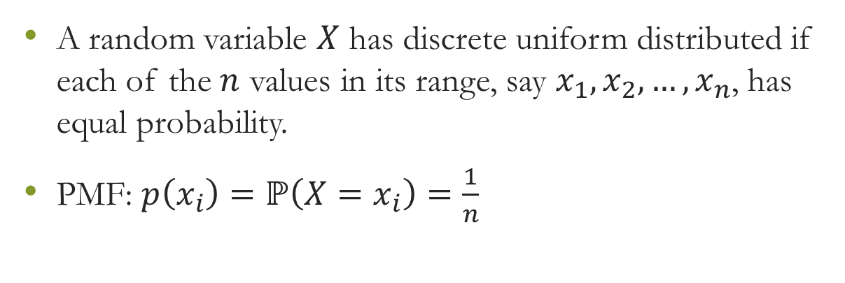



Discrete Uniform Distribution
A random variable $X$ has discrete uniform distributed if each of the $n$ values in its range, say $x_{1}, x_{2}, …, x_{n}$, has equal probability.
PMF: $p\left(x_{i}\right)=ℙ\left(X=x_{i}\right)=\frac{1}{n}$
$$p(x_{i})$$
$$\frac{1}{4}$$
$$1$$
$$2$$
$$4$$
$$3$$

Slide 28
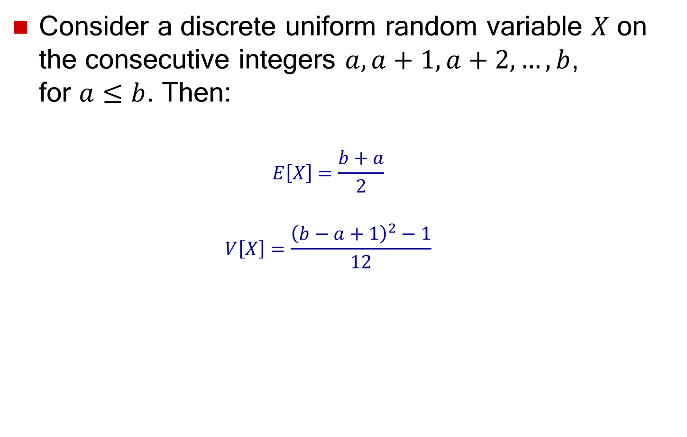
Discrete Uniform Distribution
Consider a discrete uniform random variable $X$ on the consecutive integers $a, a+1, a+2, …, b$,
for $a≤b$. Then:
  $$E\left[X\right]=\frac{b+a}{2}$$
  $$V\left[X\right]=\frac{{\left(b−a+1\right)}^{2}−1}{12}$$

Slide 29
Expected Values of Discrete Random Variables
The mean, or expected value, of a discrete random variable is

Slide 30
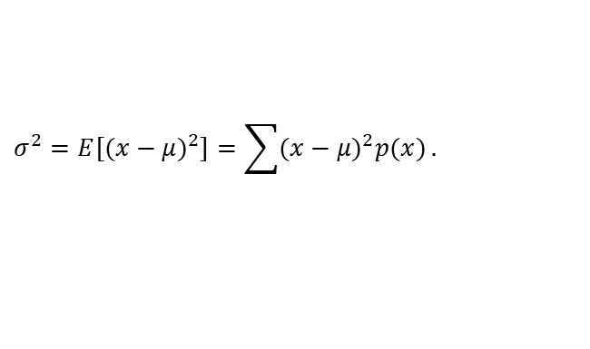
Expected Values of Discrete Random Variables
The variance of a discrete random variable x is
The standard deviation of a discrete random variable x is
$$σ^{2}=E[(x−μ)^{2}]=\sum{(x−μ)^{2}p(x)}.$$

Slide 31
Expected Values of Discrete Random Variables
In a roulette wheel in a U.S. casino, a $1 bet on “even” wins $1 if the ball falls on an even number (same for “odd,” or “red,” or “black”).
The odds of winning this bet are 47.37%
On average, bettors lose about a nickel for each dollar they put down on a bet like this.
(These are the best bets for patrons.)

Slide 32

Bernoulli Trial
Consider an experiment whose outcome can be a success with probability $p$ or a failure with probability $1−p$:
  $X=1$ if the outcome is a success
  $X=0$ if the outcome is a failure
$X$ is a Bernoulli random variable with parameter $p$
  where $0≤p≤1$ is the success probability
PMF:
$$p\left(1\right)=ℙ(X=1) =p$$
$$p\left(0\right)=ℙ(X=0) =1−p$$
Properties:
  $E\left[X\right]=p$ and $V\left[X\right]=p(1−p)$

Slide 33
Bernoulli Trial
A Binomial Random Variable
  n identical trials
  Two outcomes: Success or Failure
  P(S) = p; P(F) = q = 1 – p
  Trials are independent
  x is the number of Successes in n trials

Slide 34

The Binomial Distribution
  Flip a coin 3 times
  Outcomes are Heads or Tails
  P(H) = .5; P(F) = 1-.5 = .5
  A head on flip i doesn’t change P(H) of flip i + 1
A Binomial Random Variable
  n identical trials
  Two outcomes: Success or Failure
  P(S) = p; P(F) = q = 1 – p
  Trials are independent
  x is the number of S’s in n trials

Slide 35
The Binomial Distribution
Results of 3 flips | Probability | Combined | Summary
HHH | (p)(p)(p) | p³ | (1)p³q⁰
HHT | (p)(p)(q) | p²q
HTH | (p)(q)(p) | p²q | (3)p²q¹
THH | (q)(p)(p) | p²q
HTT | (p)(q)(q) | pq²
THT | (q)(p)(q) | pq² | (3)p¹q²
TTH | (q)(q)(p) | pq²
TTT | (q)(q)(q) | q³ | (1)p⁰q³

Slide 36

Binomial Distribution
$X$: number of successes in $n (n=1,2,…)$ independent Bernoulli trials with success probability $p$
$X$ is a binomial random variable with parameters $\left(n,p\right)$
PMF: Probability of having $k$ ($k=0,1,2,…,n$) successes in $n$ trials
  $p\left(k\right)=ℙ(X=k) =\left(\begin{matrix}n \\ k\end{matrix}\right)p^{k}{\left(1−p\right)}^{n−k}$
  where, $\left(\begin{matrix}n \\ k\end{matrix}\right)=\frac{n!}{k!\left(n−k\right)!}$
Properties:
  $E\left[X\right]=np$ and $V\left[X\right]=np(1−p)$

Slide 37
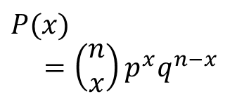
The Binomial Distribution
The Binomial Probability Distribution
  p = P(S) on a single trial
  q = 1 – p
  n = number of trials
  x = number of successes
$$P(x)=\left(\begin{matrix}n \\ x\end{matrix}\right)p^{x}q^{n−x}$$

Slide 38
The Binomial Distribution
The probability of getting the required number of successes
The probability of getting the required number of failures
The number of ways of getting the desired results

Slide 39
The Binomial Distribution
Say 40% of the class is female.
What is the probability that 6 of the first 10 students walking in will be female?

Slide 40
The Binomial Distribution
A Binomial Random Variable has
  Mean
  Variance
  Standard Deviation

Slide 41
The Binomial Distribution
For 1,000 coin flips,
The actual probability of getting exactly 500 heads out of 1000 flips is
just over 2.5%, but the probability of getting between 484 and 516 heads
(that is, within one standard deviation of the mean) is about 68%.

Slide 42
Poisson Distribution
Number of events occurring in a fixed time interval
  Events occur with a known rate and are independent
Poisson distribution is characterized by the rate λ
  Rate: the average number of event occurrences in a fixed time interval
Examples
  The number of calls received by a switchboard per minute
  The number of packets coming to a router per second
  The number of travelers arriving to the airport for flight registration per hour
Notes:
42

Slide 43
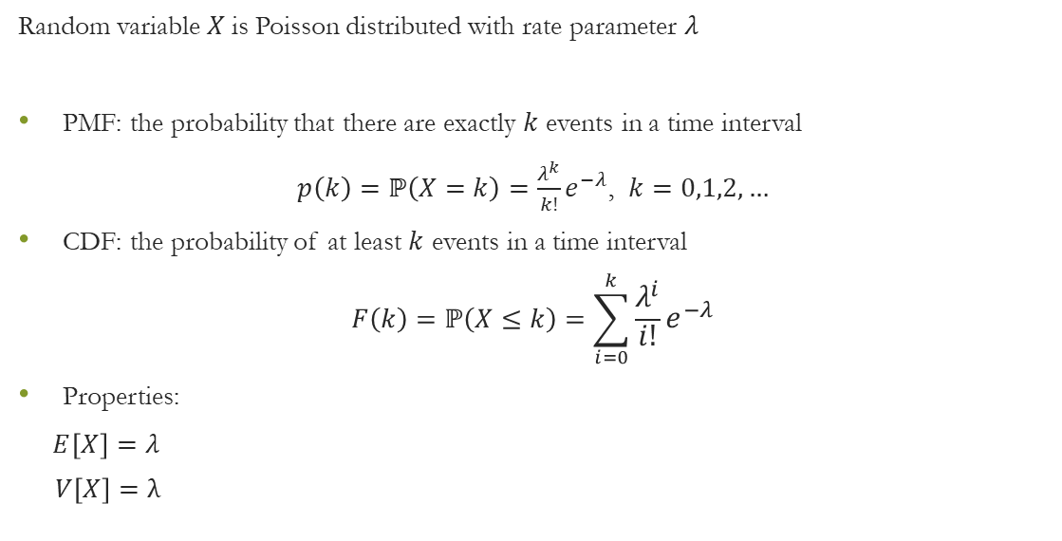
Poisson Distribution
Random variable $X$ is Poisson distributed with rate parameter $λ$
PMF: the probability that there are exactly $k$ events in a time interval
$p\left(k\right)=ℙ\left(X=k\right)=\frac{λ^{k}}{k!}e^{−λ}$, $k=0,1,2,…$
CDF: the probability of at least $k$ events in a time interval
$$F\left(k\right)=ℙ\left(X≤k\right)=\sum_{i=0}^{k}{\frac{λ^{i}}{i!}e^{−λ}}$$
Properties:
$E\left[X\right]=λ$
$$V\left[X\right]=λ$$

Slide 44

The Poisson Distribution
Say in a given stream there are an average of 3 fish per 100 yards. What is the probability of seeing 5 fish in the next 100 yards, assuming a Poisson distribution?
e = 2.71828； λ= 3

Slide 45
Example: Poisson Distribution
Poisson distribution PMF
Poisson distribution CDF

Slide 46
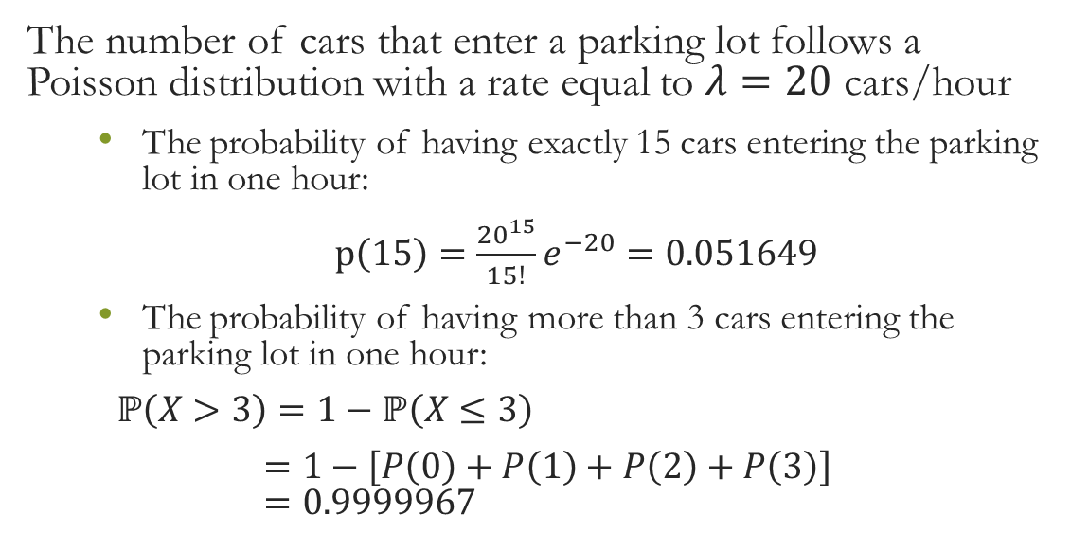
Example: Poisson Distribution
The number of cars that enter a parking lot follows a Poisson distribution with a rate equal to $λ=20$ cars/hour
  The probability of having exactly 15 cars entering the parking lot in one hour:
  $p\left(15\right)=\frac{{20}^{15}}{15!}e^{−20}=0.051649$
  The probability of having more than 3 cars entering the parking lot in one hour:
  $ℙ\left(X>3\right)=1−ℙ\left(X≤3\right)$
  $=1−\left[P\left(0\right)+P\left(1\right)+P\left(2\right)+P\left(3\right)\right]$
  $=0.9999967$

Slide 47
Outline
Probability and random variables
  Random experiment and random variable
  Probability mass/density functions
  Expectation, variance, covariance, correlation
Probability distributions
  Discrete probability distributions
  Continuous probability distributions

Slide 48
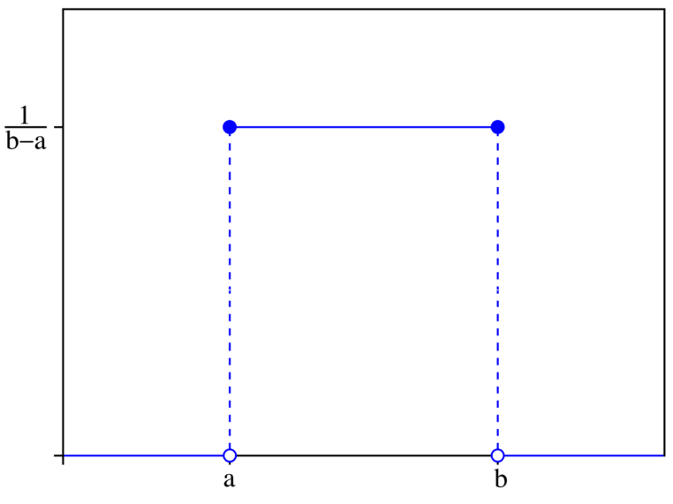
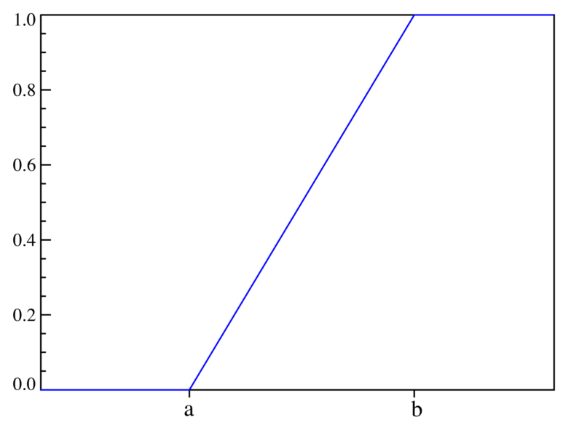
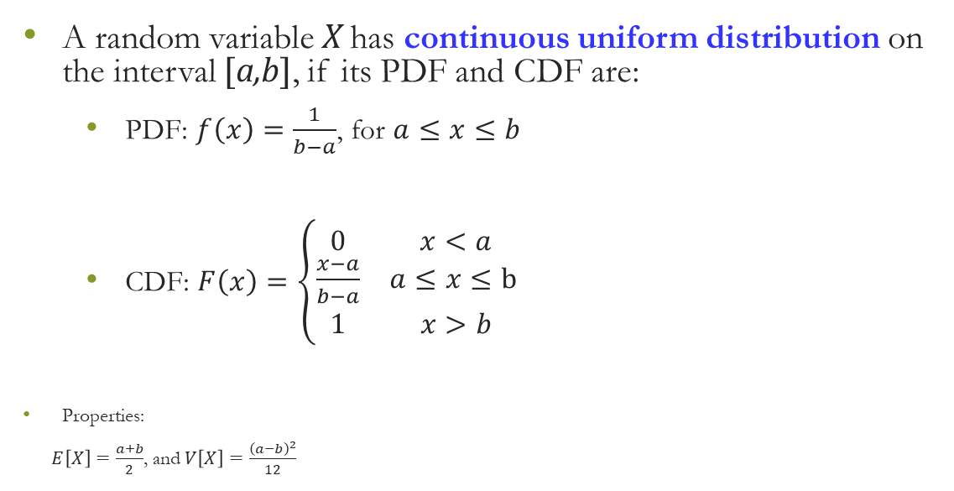
Uniform Distribution
A random variable X has continuous uniform distribution on the interval [a,b], if its PDF and CDF are:
  PDF: $f\left(x\right)=\frac{1}{b−a}$, for $a≤x≤b$
  CDF: $F\left(x\right)=\left\{\begin{matrix}0 & x<a \\ \frac{x−a}{b−a} & a≤x≤b \\ 1 & x>b\end{matrix}\right.$
Properties:
$E\left[X\right]=\frac{a+b}{2}$, and $V\left[X\right]=\frac{{\left(a−b\right)}^{2}}{12}$
PDF
CDF

Slide 49
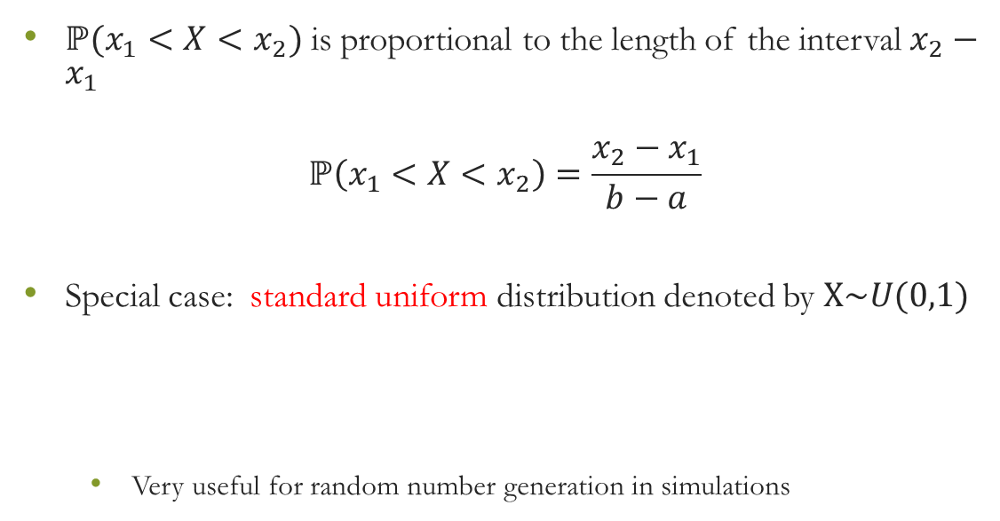
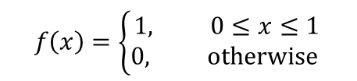
Uniform Distribution Properties
$ℙ(x_{1}<X<x_{2})$ is proportional to the length of the interval $x_{2}−x_{1}$
$$ℙ\left(x_{1}<X<x_{2}\right)=\frac{x_{2}−x_{1}}{b−a}$$
Special case: standard uniform distribution denoted by $X\sim U(0,1)$
  Very useful for random number generation in simulations
$$f\left(x\right)=\left\{\begin{matrix}1, 0≤x≤1 \\ 0, \text{otherwise} \end{matrix}\right.$$

Slide 50
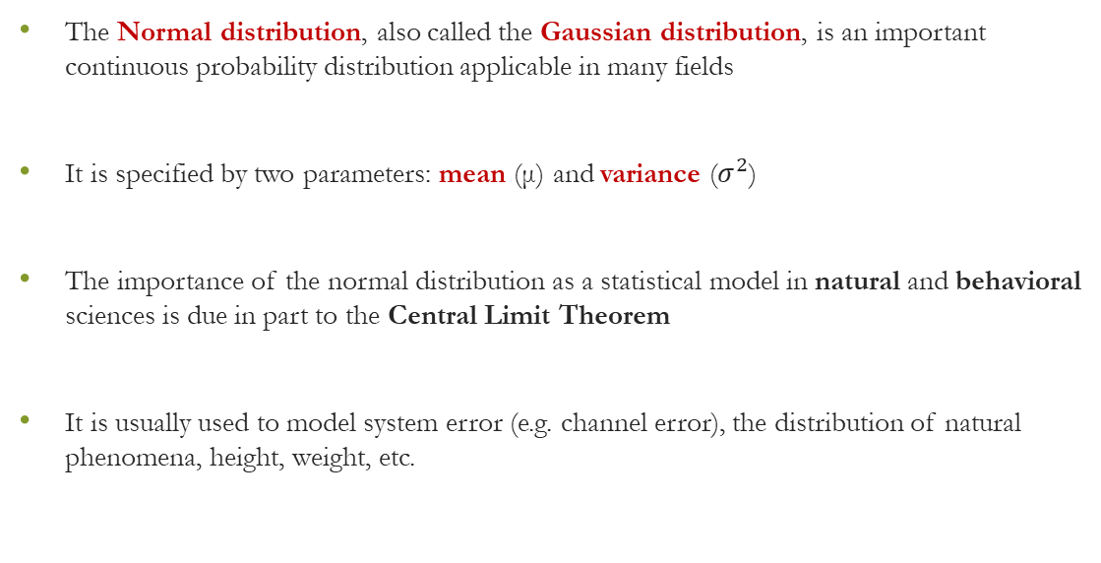
Normal Distribution
The Normal distribution, also called the Gaussian distribution, is an important continuous probability distribution applicable in many fields
It is specified by two parameters: mean (μ) and variance ($σ^{2}$)
The importance of the normal distribution as a statistical model in natural and behavioral sciences is due in part to the Central Limit Theorem
It is usually used to model system error (e.g. channel error), the distribution of natural phenomena, height, weight, etc.

Slide 51
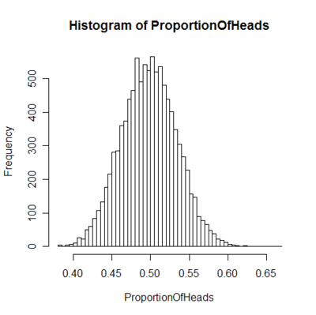
Central Limit Theorem
Histogram plot of average proportion of heads in a fair coin
toss, over a large number of sequences of coin tosses.

Slide 52
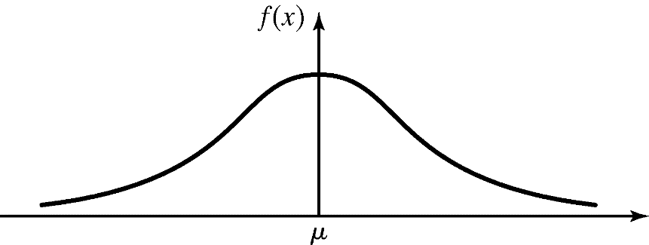

Normal Distribution
Random variable X is normally distribution with
parameters $\left(μ, σ^{2}\right)$, i.e., $X\sim N(μ, σ^{2})$:
  PDF: $f\left(x\right)=\frac{1}{σ\sqrt{2π}}e^{−\frac{1}{2}{\left(\frac{x−μ}{σ}\right)}^{2}}$, for $−∞≤x≤+∞$
  CDF: does not have any closed form!
  $E\left[X\right]=μ$, and $V\left[X\right]=σ^{2}$
Properties:
  $\lim_{x→±∞}f\left(x\right)=0⁡$
  Normal PDF is a symmetrical, bell-shaped curve
  centered at its expected value $μ$
  Maximum value of PDF occurs at $x=μ$

Slide 53
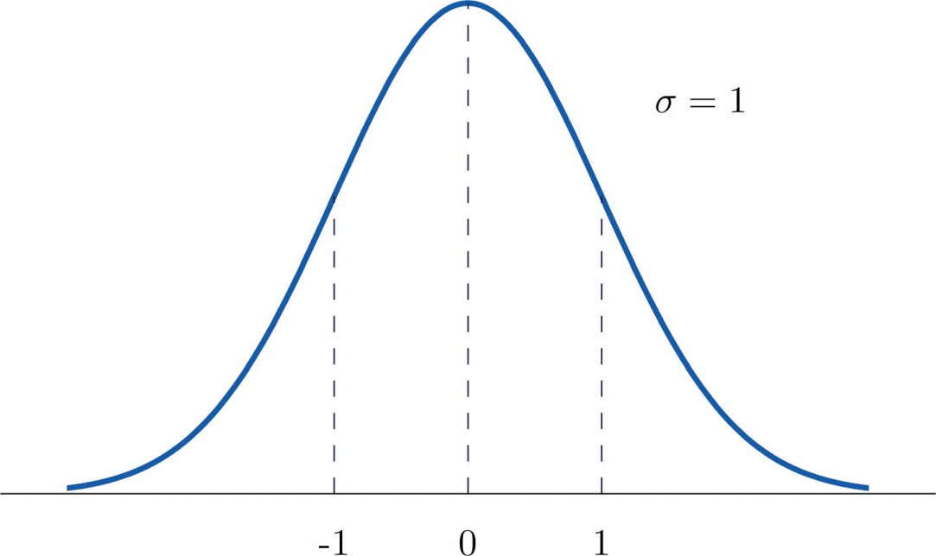
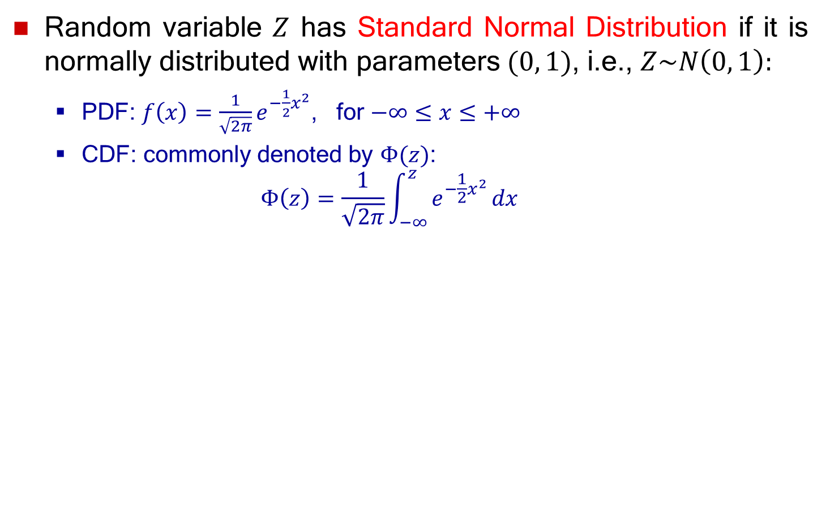
Standard Normal Distribution
Random variable $Z$ has Standard Normal Distribution if it is normally distributed with parameters $(0, 1)$, i.e., $Z\sim N\left(0, 1\right):$
  PDF: $f\left(x\right)=\frac{1}{\sqrt{2π}}e^{−\frac{1}{2}x^{2}}$, for $−∞≤x≤+∞$
  CDF: commonly denoted by $Φ(z)$:
  $$Φ\left(z\right)=\frac{1}{\sqrt{2π}}\int_{−∞}^{z}{e^{−\frac{1}{2}x^{2}}}dx$$

Slide 54

Normal Distribution
Evaluating the distribution $X\sim N\left(μ, σ^{2}\right)$:
  $F\left(x\right)=ℙ\left(X≤x\right)?$
Two techniques:
Use numerical methods (no closed form)
Use the standard normal distribution
  $Φ(z)$ is widely tabulated
  Use the transformation $Z=\frac{X−μ}{σ}$
  If $X\sim N(μ, σ^{2})$ then $Z\sim N(0, 1)$, i.e., standard normal distribution:
  $$F\left(x\right)=ℙ\left(X≤x\right)=ℙ\left(\frac{X−μ}{σ}≤\frac{x−μ}{σ}\right)$$
  $$=ℙ\left(Z≤\frac{x−μ}{σ}\right)=Φ\left(\frac{x−μ}{σ}\right)$$

Slide 55
Normal Probability Distribution
Characteristics (basis for the empirical rule)
99.72%
95.44%
68.26%
μ
x
μ – 3σ
μ – 1σ
μ + 1σ
μ + 3σ
μ – 2σ
μ + 2σ

Slide 56
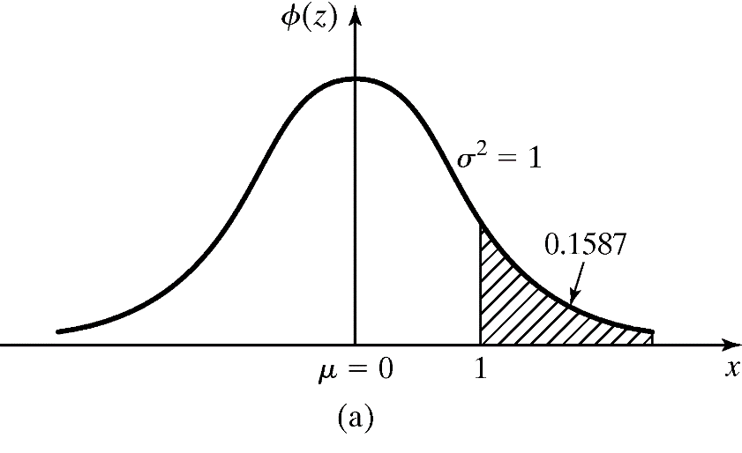
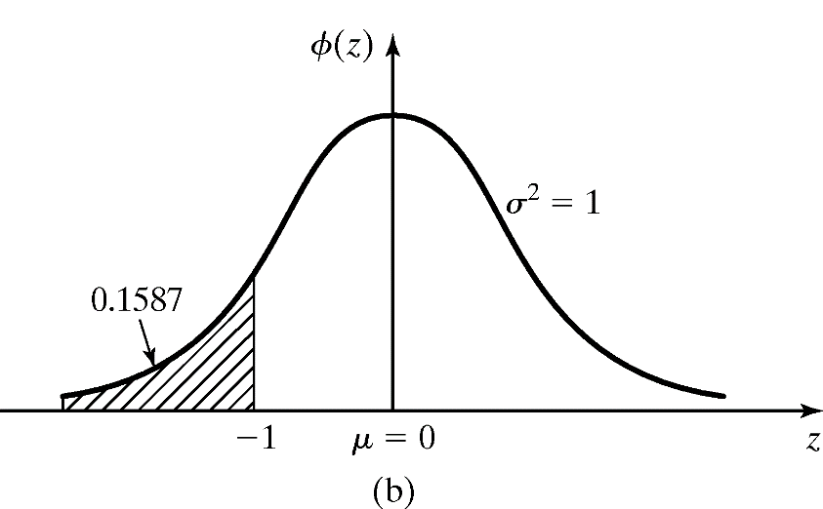

Normal Distribution
Example: The time required to load an oceangoing vessel, $X$, is distributed as $N(12, 4)$
  The probability that the vessel is loaded in less than 10 hours:
  $$F\left(10\right)=Φ\left(\frac{10−12}{2}\right)=Φ\left(−1\right)=0.1587$$
  Using the symmetry property, Φ(1) is the complement of Φ (-1)

Slide 57
Standard Normal Probability Distribution
Cumulative Probability Table for the Standard Normal Distribution
z
.00
.01
.02
.03
.04
.05
.06
.07
.08
.09
.
.
.
.
.
.
.
.
.
.
.
.5
.6915
.6950
.6985
.7019
.7054
.7088
.7123
.7157
.7190
.7224
.6
.7257
.7291
.7324
.7357
.7389
.7422
.7454
.7486
.7517
.7549
.7
.7580
.7611
.7642
.7673
.7704
.7734
.7764
.7794
.7823
.7852
.8
.7881
.7910
.7939
.7967
.7995
.8023
.8051
.8078
.8106
.8133
.9
.8159
.8186
.8212
.8238
.8264
.8289
.8315
.8340
.8365
.8389
.
.
.
.
.
.
.
.
.
.
.
P(z < .83) = .7967

Slide 58
Standard Normal Probability Distribution
Compute the area under the standard normal
curve to the right of z = .83.
P(z > .83) = 1 – P(z < .83)
= 1- .7967
= .2033

Slide 59
Exponential Probability Distribution
The exponential probability distribution is useful in describing the time it takes to complete a task.
The exponential random variables can be used to describe:
Time between vehicle arrivals at a toll booth
Time required to complete a questionnaire
Distance between major defects in a highway
In waiting line applications, the exponential distribution is often used for service time.

Slide 60
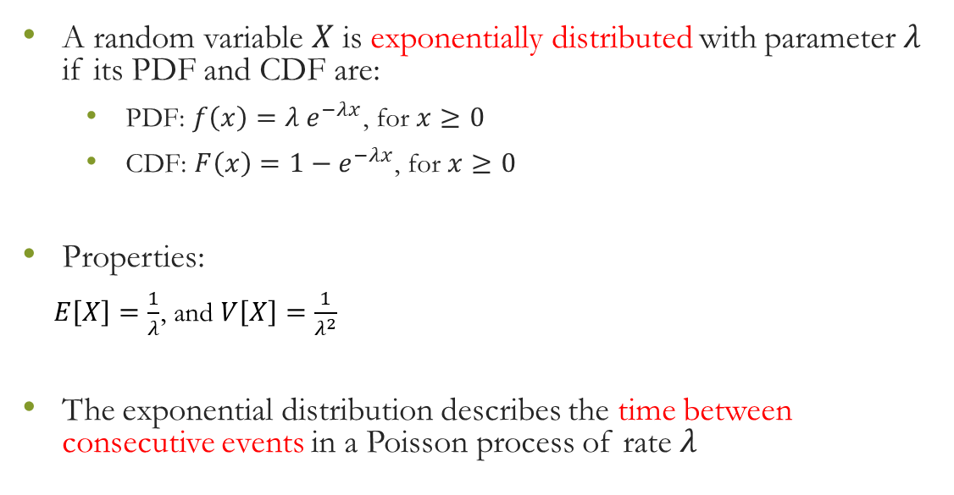
Exponential Distribution
A random variable $X$ is exponentially distributed with parameter $λ$ if its PDF and CDF are:
  PDF: $f\left(x\right)=λ e^{−λx}$, for $x≥0$
  CDF: $F\left(x\right)=1−e^{−λx}$, for $x≥0$
Properties:
  $E\left[X\right]=\frac{1}{λ}$, and $V\left[X\right]=\frac{1}{λ^{2}}$
The exponential distribution describes the time between consecutive events in a Poisson process of rate $λ$

Slide 61
Example: Exponential Distribution
Exponential distribution PDF
Exponential distribution CDF

Slide 62


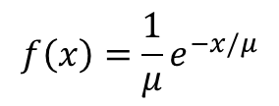
Exponential Probability Distribution
Density Function
$$f\left(x\right)=\frac{1}{μ}e^{−x/μ}$$
for $x$> 0
where: μ = expected value or mean
e = 2.71828
Cumulative Probabilities
$P$(x < $x$₀ )$=1−e^{−x_{0}/μ}$
where:
x₀ = some specific value of x

Slide 63
Exponential Probability Distribution
Example: Al’s Full-Service Pump
The time between arrivals of cars at Al’s full-service gas pump follows an exponential probability distribution with a mean time between arrivals of 3 minutes. Al would like to know the probability that the time between two successive arrivals will be 2 minutes or less.

Slide 64
Exponential Probability Distribution
Example: Al’s Full-Service Pump
f(x)
.4
P(x < 2) = 1 - 2.71828^{-2/3} = 1 - .5134 = .4866
.3
.2
.1
x
0 1 2 3 4 5 6 7 8 9 10
Time Between Successive Arrivals (mins.)

Slide 65
Relationship between the Poisson and Exponential Distributions
The Poisson distribution
provides an appropriate description
of the number of occurrences
per interval.
The exponential distribution
provides an appropriate description
of the length of the interval
between occurrences.

Slide 66
The Gamma Distribution and Its Relatives

Slide 67
The Gamma Function
the gamma function

Slide 68
Gamma Distribution
A continuous rv X has a gamma distribution if the pdf is
where the parameters satisfy
The standard gamma distribution has

Slide 69
Mean and Variance
The mean and variance of a random variable X having the gamma distribution

Slide 70
Probabilities from the Gamma Distribution
Let X have a gamma distribution with parameters
Then for any x > 0, the cdf of X is given by
where
70

Slide 71
The Chi-Squared Distribution
Let v be a positive integer. Then a random variable X is said to have a chi-squared distribution with parameter v if the pdf of X is the gamma density with
The pdf is

Slide 72
The Chi-Squared Distribution
The parameter v is called the number of degrees of freedom (df) of X. The symbol is often used in place of “chi-squared.”

Slide 73
The Weibull Distribution
A continuous rv X has a Weibull distribution if the pdf is
where the parameters satisfy

Slide 74
Mean and Variance
The mean and variance of a random variable X having the Weibull distribution are

Slide 75
Weibull Distribution
The cdf of a Weibull rv having parameters

Slide 76
Beta Distribution
A rv X is said to have a beta distribution with parameters A, B,
if the pdf of X is

Slide 77
Mean and Variance
The mean and variance of a variable X having the beta distribution are

