Slide 1


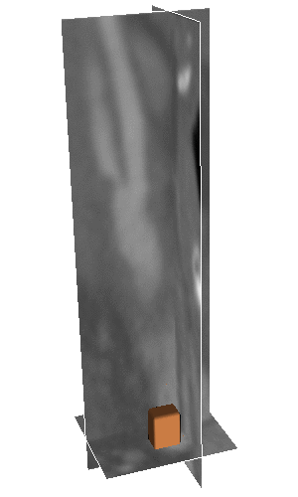
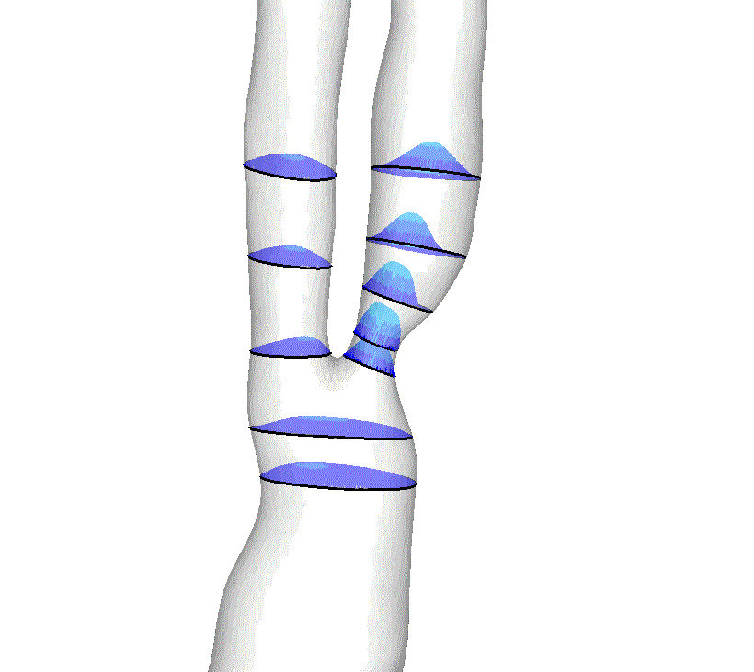
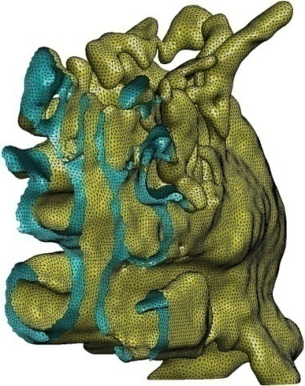
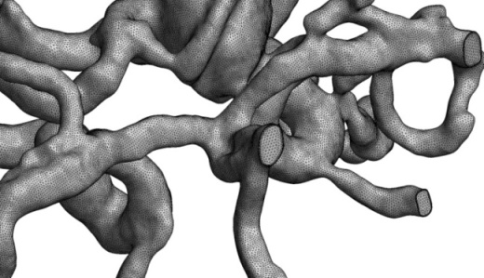
Constructing geometries for the patient specific modelling
Igor Sazonov,
X.Xie, P.Nithiarasu, R.vanLoon R.Bevan, E.Boileau, ...
Swansea University, U.K.
Moscow, 16 April 2014

Slide 2
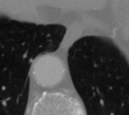
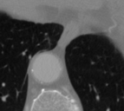
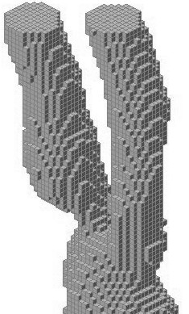
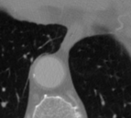
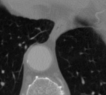
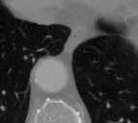
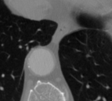
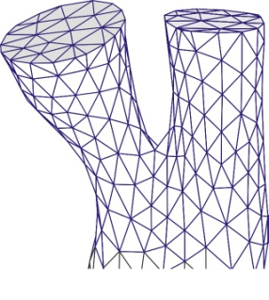
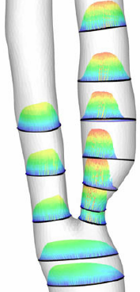
Motivation
Often used:
Amira/Mimics
ANSYS
Fluent
Frame-work of the patient-specific modelling
Medical Scans
Binary
image
1. Segmentation
Issues:
Efficiency
Robustness
Justification
2. Meshing
Mesh
Numerical
results
Swansea University: experience in
mesh generation, CFD, …
3. Flow solution

Slide 3
Outlines
Modified GPF segmentation method (4D example CT)
Skeletonization
Meshing issues
Boundary conditions (1D-3D matching)
WSS convergence

Slide 4
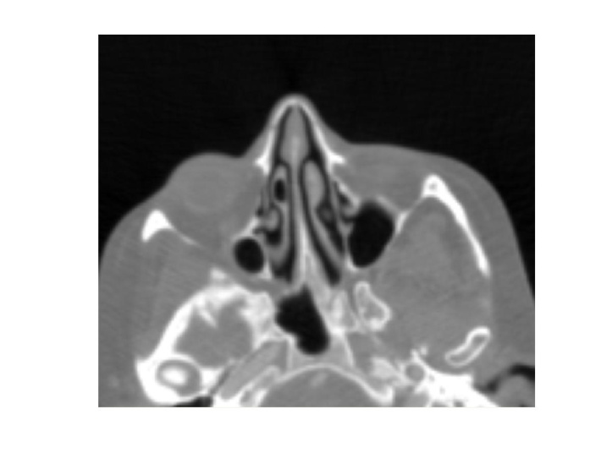
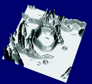
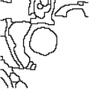
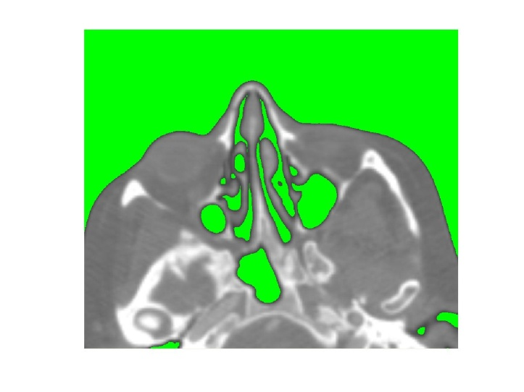
Segmentation: methods
Intensity based
Gradient based
Thresholding, region growth, etc
Watershed, etc
Relief of the gradient
Watershed

Slide 5


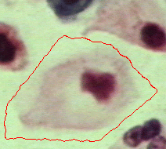








Deformable models: active contour, snakes, balloons,
Gradient Vector Flow (GVF)
is the unity vector normal to S
Generalized GVF
the edge stopping edge function
the curvature of contour S
Levelset function
GVF:
or
Generalized Gradient Vector Flow

Slide 6
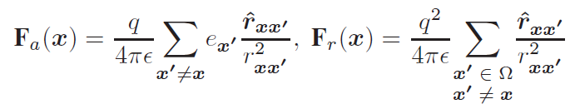


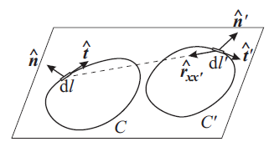
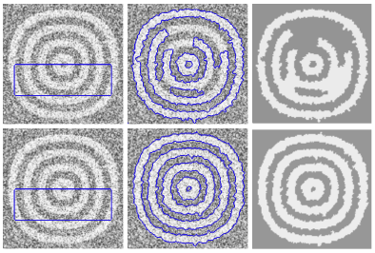
Electromagnetic analogy
Charged-Particle model
Magneto Active Contour model (Biot–Savart law)
Active contour
Object

Slide 7
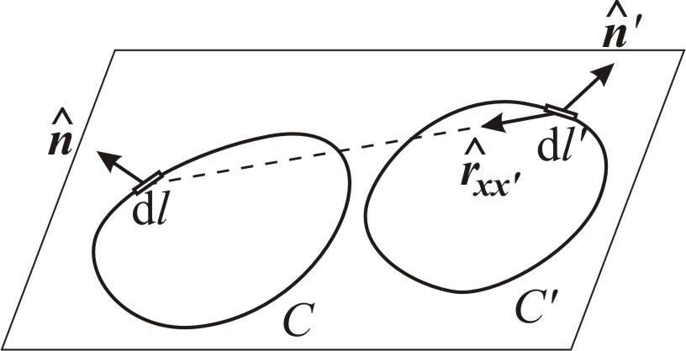
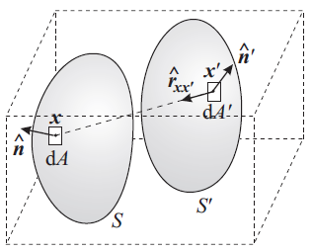




Geometrical potential force (GPF)
S. Yeo, X. Xie, I. Sazonov and P. Nithiarasu 2011:
Geometrically induced force Interaction for three-dimensional deformable models,
IEEE Transactions on Image Processing

Slide 8









The GPF method
Given a greyscale image I(x) in an n-dimensional domain Ω
the vector of coordinates of the image grid-points
Stage 1: Computation of geometrical potential G(x)
vector kernel
the image gradient
Stage 2: computation of geometrical potential G for greyscale image I(x)
the curvature of isosurfaces
stopping function
is the unit vector normal to isosurfaces of Φ
surface driving force

Slide 9



Computation of geometric potential
Method 0: Direct sum: very slow - suitable for small 2D images only
Method 1: Using Convolution Theorem
Fourier transform:
S. Yeo, X. Xie, I. Sazonov and P. Nithiarasu 2011: Geometrically induced force Interaction for three-dimensional deformable models, IEEE Transactions on Image Processing

Slide 10

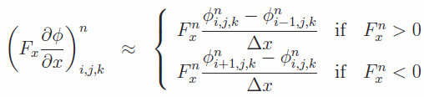
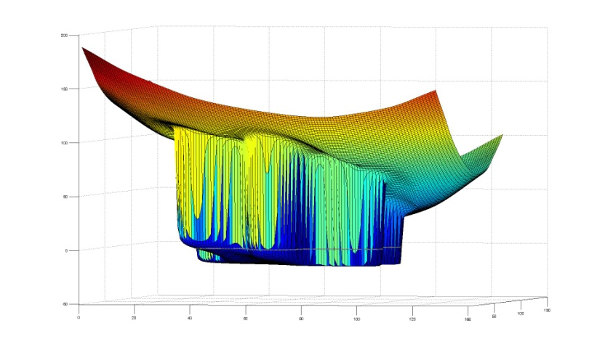
Integration of the PDE
Discretising
Central differences
Forward/backward differences
Shock-wave like solution
Felzenszwalb&Huttenlocher 2004
Distance Transforms of Sampled Functions

Slide 11
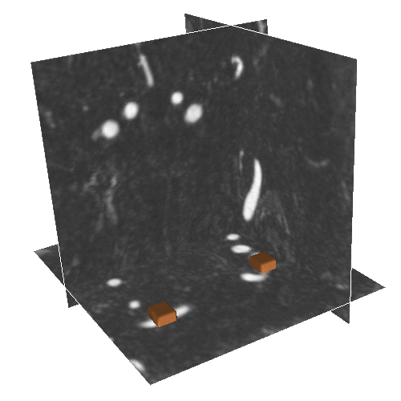
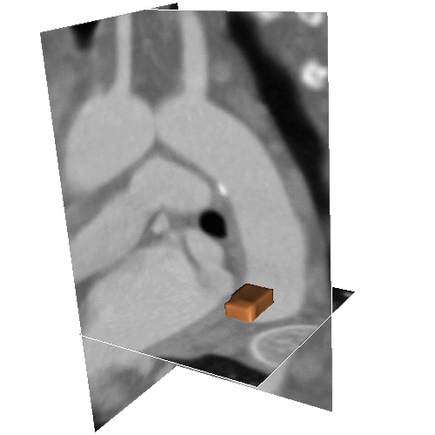
Segmentation by GPF of blood vessels
Carotid
Aorta
Cerebral arteries

Slide 12
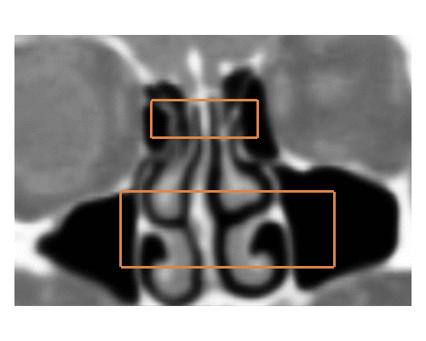
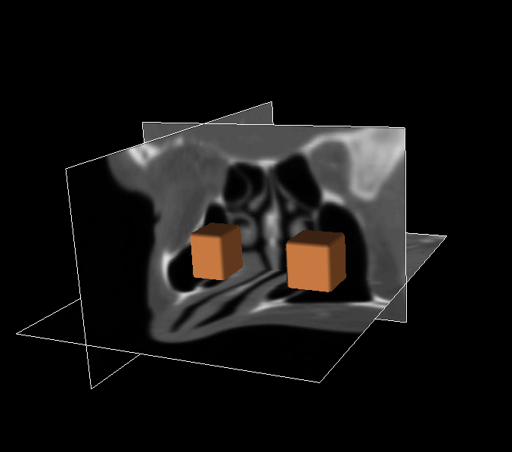
Segmentation by GPF of nasal part
3D
GGVF
GPF

Slide 13






How many arrays to compute and store in Method 1?
3D:Arrays to be allocated of size of I
3D: 20;
4D: 26, etc.
3D: 512x512x512 ~ 1G
20G is needed
To main approaches are proposed to optimise computation of G(x)
Derive an analytical formula for the kernel spectrum (then no necessity to store its components: economy in two times)
Pass to scalar multiples in the sum by transferring ∇ from I to K : economy in n times)

Slide 14








Method 2
Discrete form
Continuous form
The kernel in the continuous form is a distribution (generalized function) ∈ D’
Kernel (discrete form)
Kernel (continuous form)
Theorem 1:
= nD unit-sphere area
Its spectrum F[K] = ik/|k|
Riesz transform kernel: K = (1/B_{n}) P.V. x/|x|^{n+1}

Slide 15






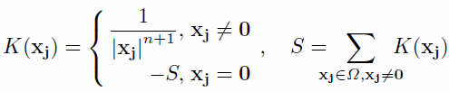
Method 3
Type of integration by parts:
Introduce a scalar kernel:
Much easier to understand this in the k-space ∇ ↔ ik:
Scalar kernel K(x) is also a distribution with the higher order singularity:
Its discrete analogue is

Slide 16




Method 4: combining methods 2 and 3
Analytical spectrum for the scalar kernel
Very economic!
Linear integral transform:
Linear operator:
If we apply this operator twice:
in the k-space (-B_{n}|k|) (-B_{n}|k|) = B_{n}² |k|²
it is the same to apply the Laplace operator ∇² (times a constant):
which spectrum is -|k|²
Thus
Comparison of efficiency of all the modifications for a 256³ image

Slide 17
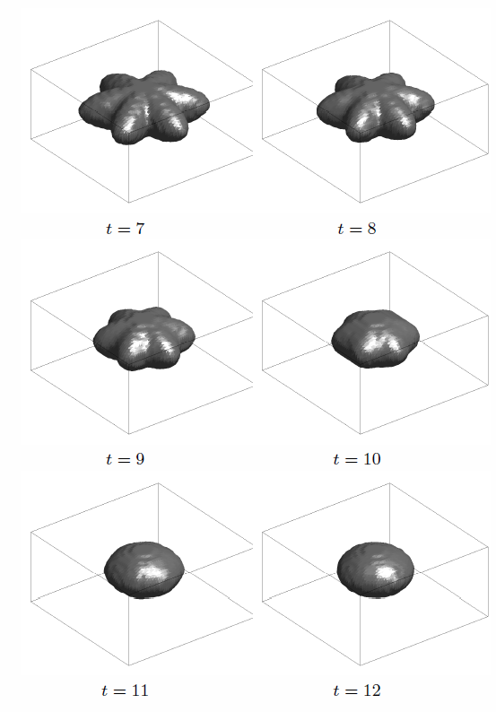
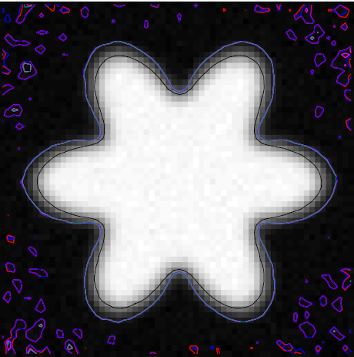
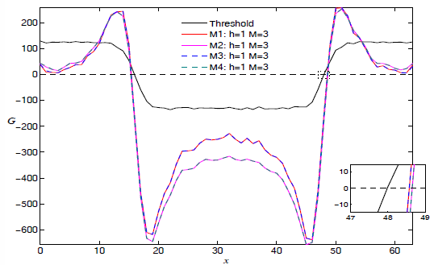
4D artificial image

Slide 18
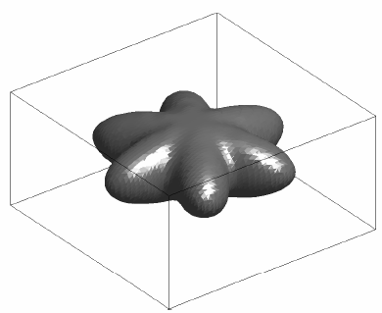
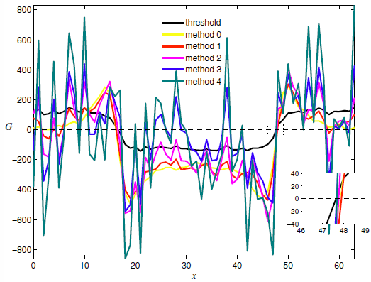
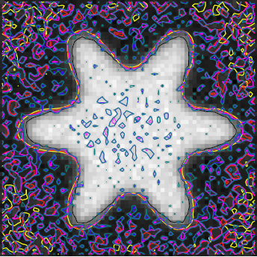
Artificial images + noise

Slide 19


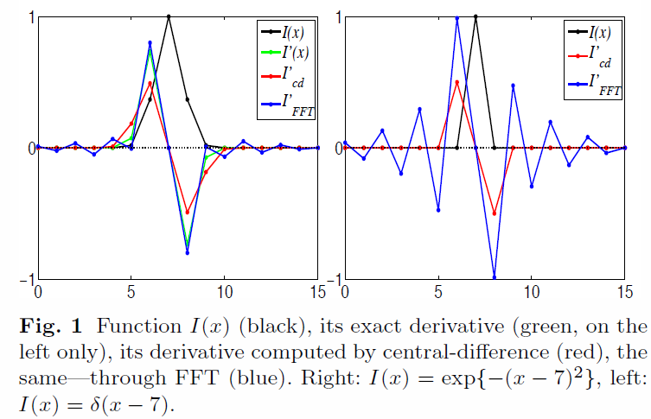





Decreasing sensitivity to noise
Derivative in method 0,1,2: central difference
Derivative in method 3,4: through FFT
Derivative through a convolution
Its spectrum
Central-difference is a convolution with the kernel
Its spectrum

Slide 20




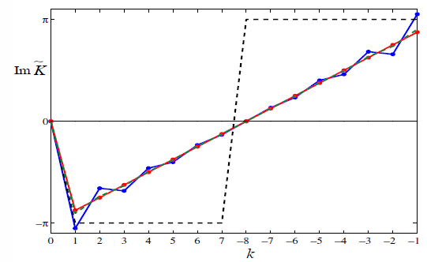
Passing to the central differences:
Filtering highest harmonics:
Spectrum of PV(1/x):
analytical: black-dashed;
discrete-via FFT: blue
smoothed-discrete: red

Slide 21


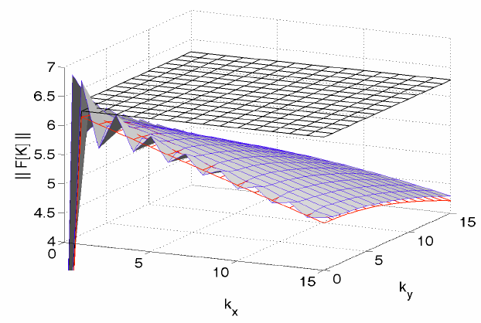
Filtering highest harmonics in a higher dimension:
V(k) is a cumbersome function but easily implementable

Slide 22
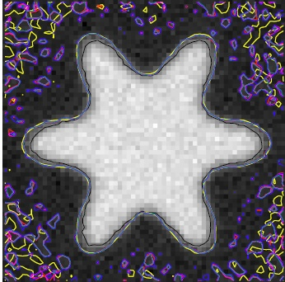
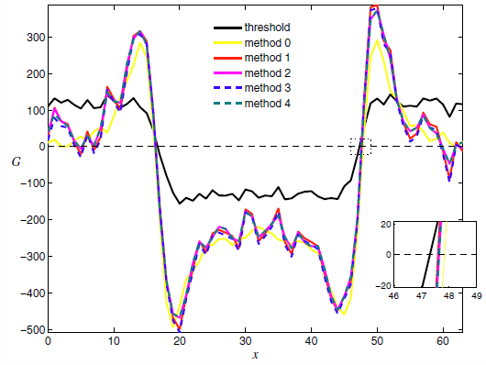
Methods 2-4 with the corrections described above:

Slide 23
4D artificial image

Slide 24
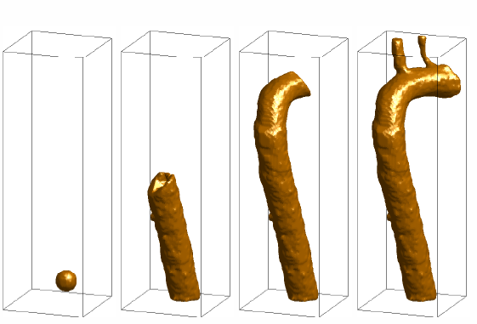
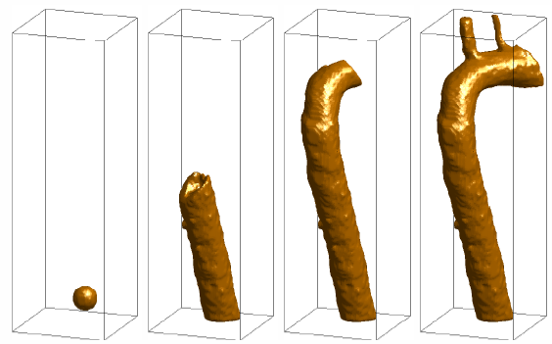
3D medical scans (CT)
Method 1
Method 4

Slide 25
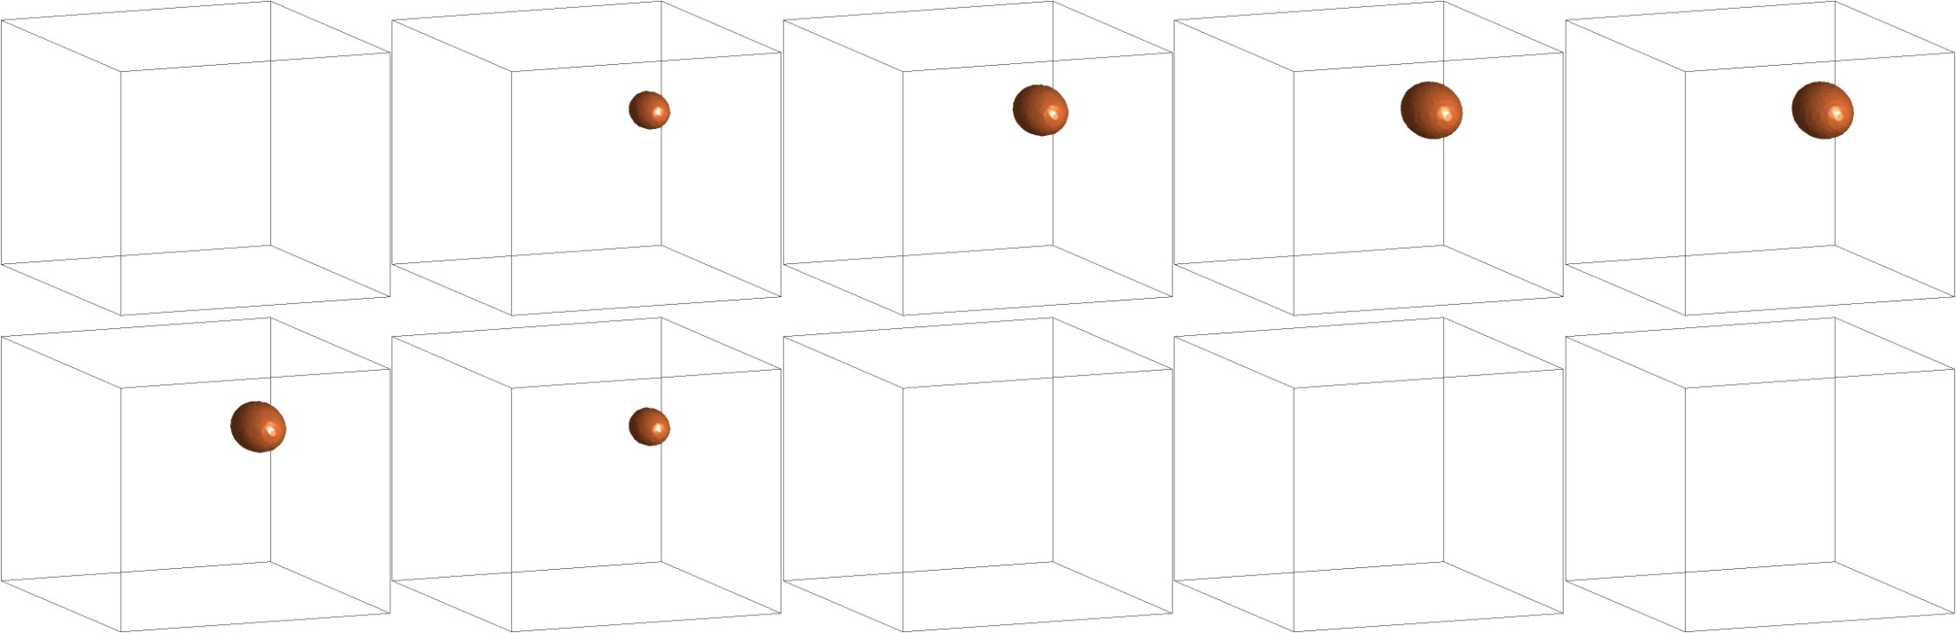
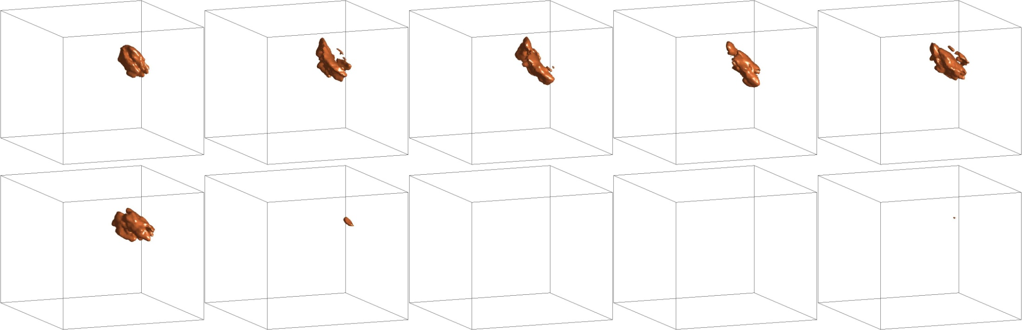
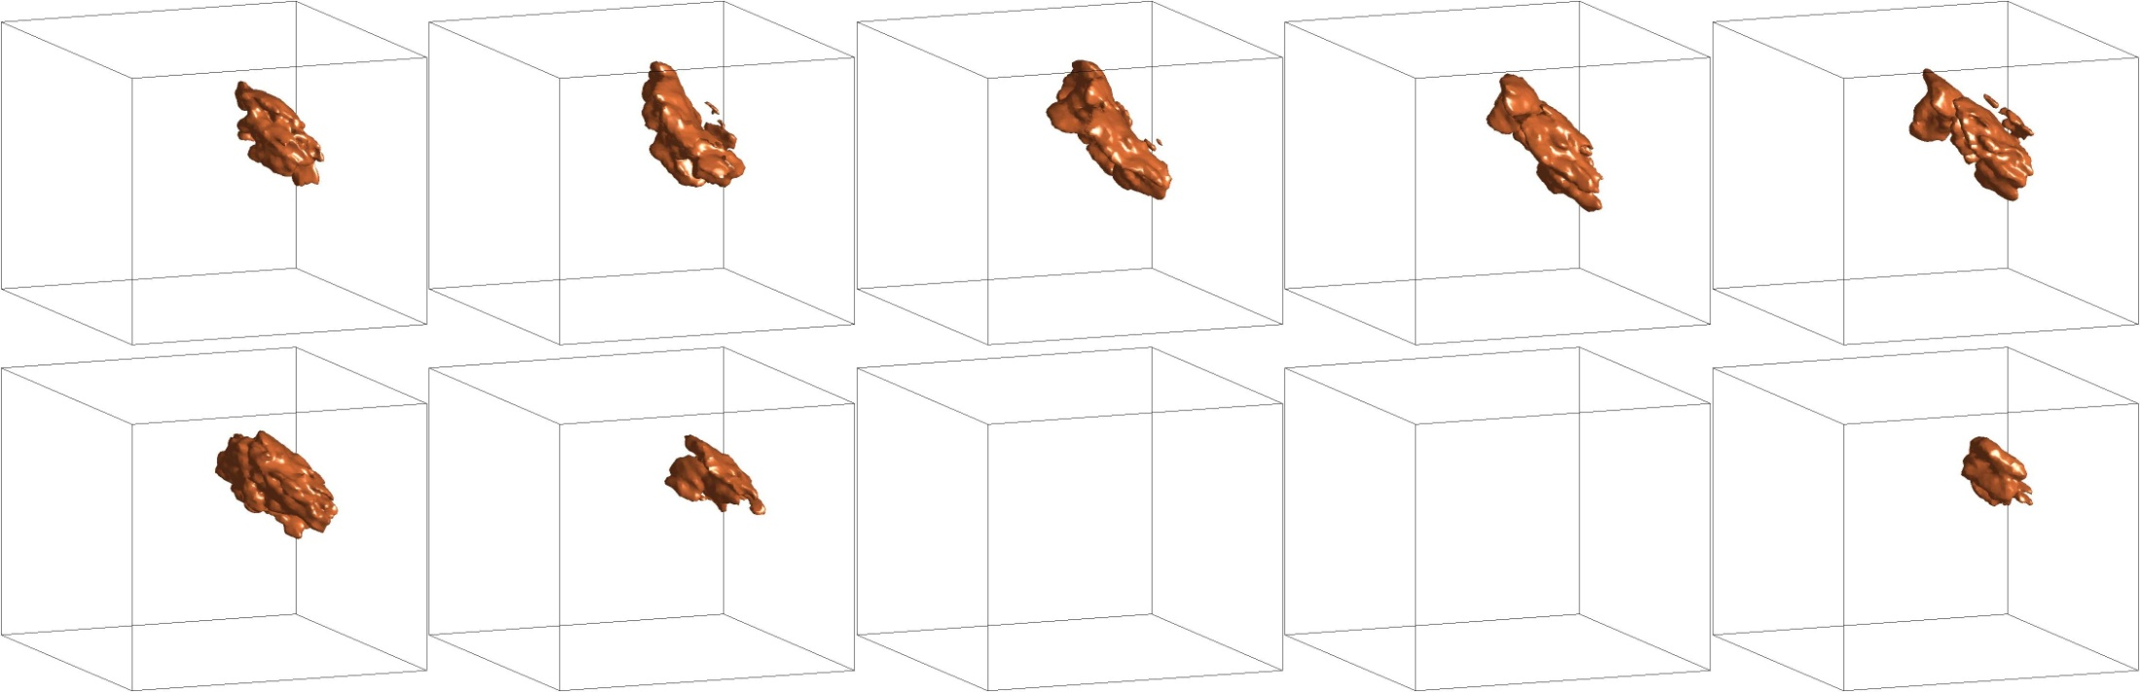
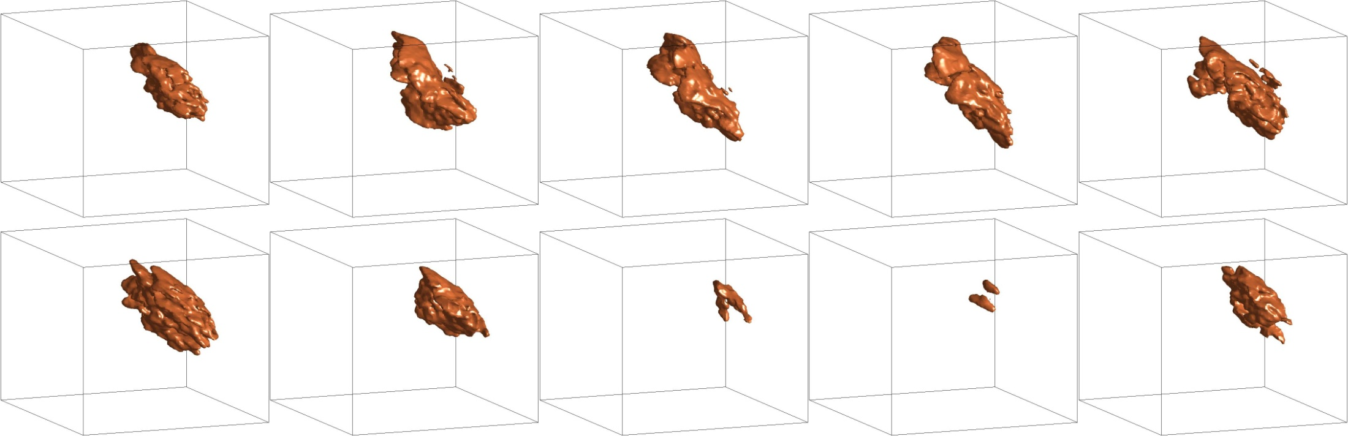
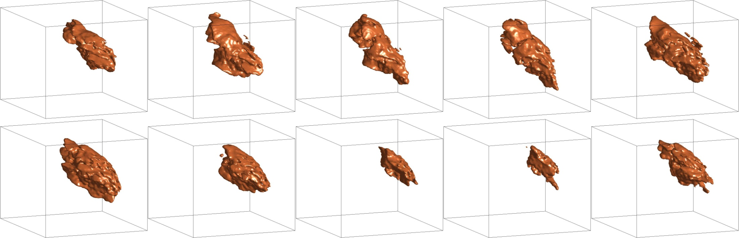
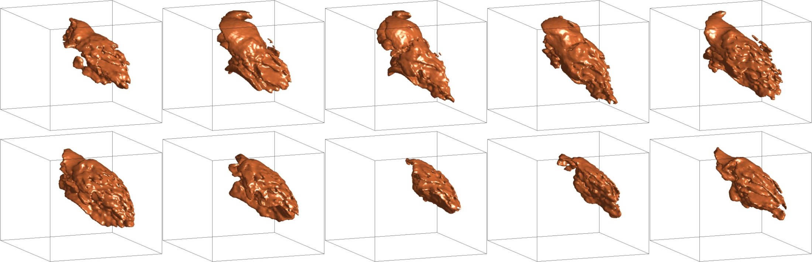
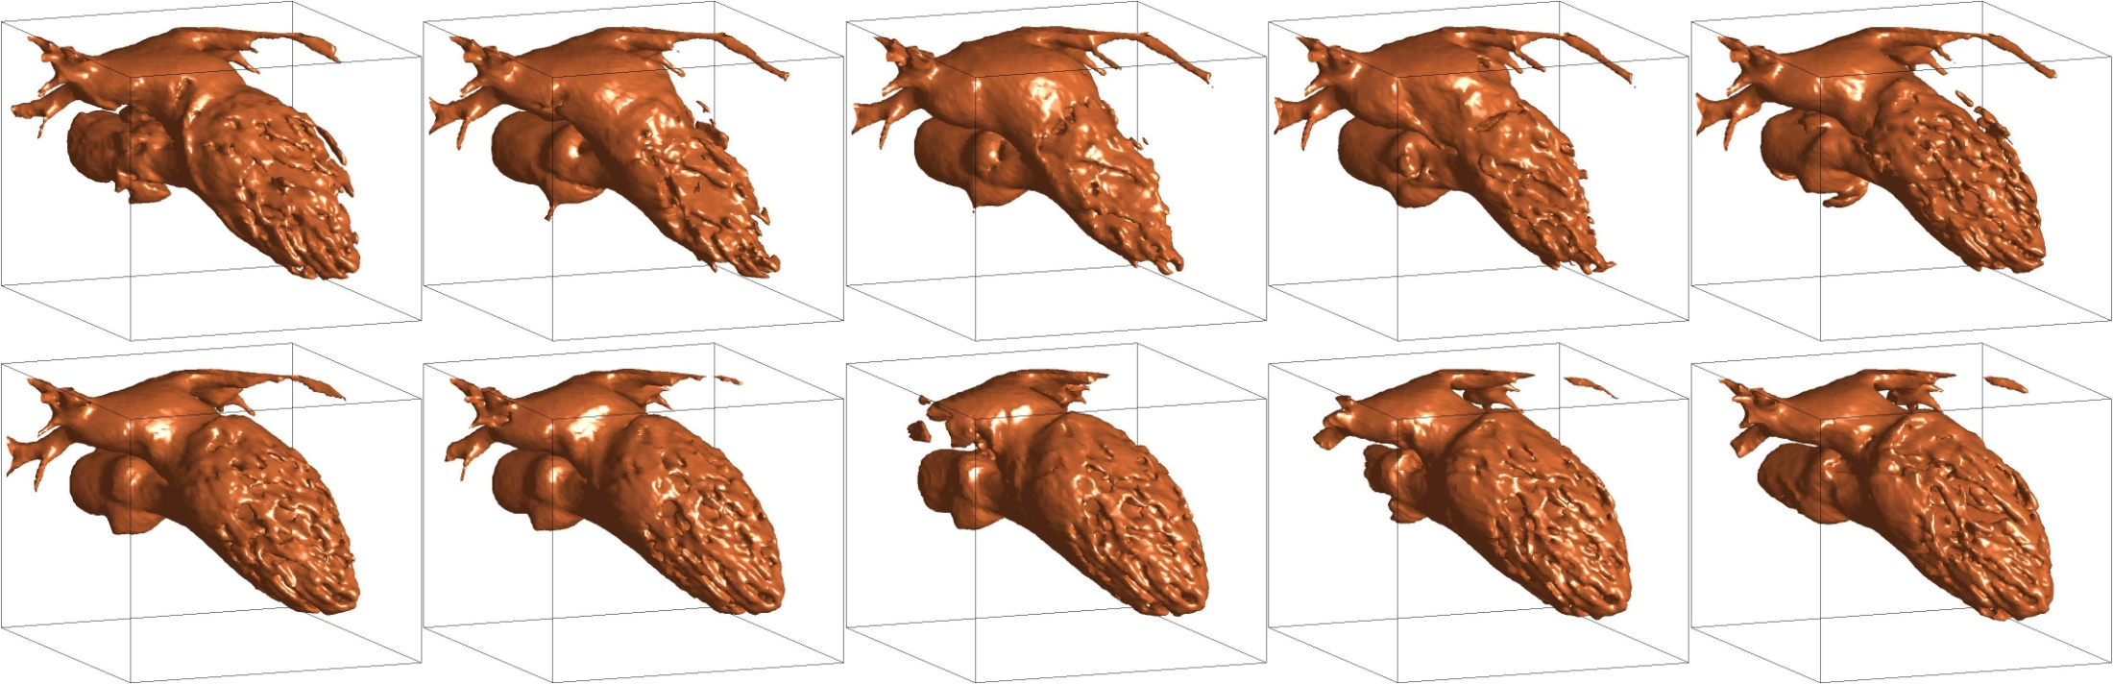


3D+T medical scans (CT)
Image 256 x 256 x 155 x 10. Method 4 Computation of G(x): 260s 2.5G
Advancing the PDE ~ 2h:
Voxel size: 0.57 × 0.57 × 0.9 × 5 mm
Issue: voxel size in time?!

Slide 26





Lymphatic valve segmentation (Confocal laser scanning microscopy )
Graph-cuts approach

Slide 27



Lymphatic valve segmentation (walls and leaflets)

Slide 28


Lymphatic valve segmentation (mesh)
Patient-specific geometry
Idealized geometry for numerical modelling

Slide 29




Skeletonization
Piccinelli et al 2009
Sazonov, I.A. 1990: Selection of the centroidal line in curved beams of variable cross section, Акуст.ж. (Acoust. J)

Slide 30





Skeletonization: Voxel thinning
Voxel thinning
Line analysing and smoothing
Standard approach
Our approach
Line smoothing method
1. Lee et all 1991: Winding and Euler numbers for 2d and 3d images. Computer Vision
2. Huang et all 2009: On coincide 3d simple point characterizations: a marching cubes paradigm. IEEE Transaction on Medical Imaging

Slide 31

Meshing: Mesh requirements
Elements of surface and volume mesh should have a proper size
Elements of surface and volume mesh should have a quality: aspect ratio should not be too small
Plane inlets and outlets should be properly defined. They should be directed normally to the blood vessel axis
Boundary layer near-wall mesh: short edges of tetrahedra are normal to the wall, they are much shorter than the element size in the volume

Slide 32




Meshing: methods
NURBS patches
Surface is defined by a set of 2D contours
Surface is defined by a cloud of points

Slide 33





Meshing: re-gridding methods
Re-gridding: new nodes are placed on faces of initial mesh by Advancing front
Mapping onto a plane, plane triangulation, back mapping
Mesh cosmetic of the initial mesh
D.Wang, O.Hassan, K.Morgan, and N.P.Weatherill 2006: EQSM: An effective high quality surface grid generation method based on remeshing
D.Wang, O.Hassan, K.Morgan, and N.P.Weatherill 2007: Enhanced remeshing from STL files with applications to surface grid generation

Slide 34


Initial mesh: Marching Cube (MC)
Standard MC: binary object
Advanced MC: Smooth Level Set function
Lorensen & Cline 1987: Marching Cubes: A high resolution 3D surface construction algorithm, Computer Graphics, 21(4).
Chernyaev. 1995: Marching cubes 33: Construction of topologically correct isosurfaces. Technical report CN 95–17, CERN,.
Φ = a²-x²-y²−z²

Slide 35

Cropping the mesh

Slide 36



Outlet direction correction
N
T
t_{w}
t_{w}
n_{w}
n_{w}
T
N
t_{w}
t_{w}
Convergence of the iteration

Slide 37





Mesh cosmetics
Mesh smoothing:
Edge swapping:
Edge sizing:
Element quality =
Aspect ratio
Aspect ratio of the
perfect triangle
Shortest height
Aspect ratio =
Longest side

Slide 38




Surface mesh for thoracic aorta
Mesh quality histogram
Original kink
Edge length histogram
Smoothed kink
Cropped initial mesh
Final mesh
Bevan et al. (2010) Patient-specific blood flow simulation through an aneurysmal thoracic aorta 3 with a folded proximal neck. Int.J.Num.Meth. Biomeg. Engng.

Slide 39




Surface mesh the nasal cavity
Binary → Gray with the double resolution.
Then the advanced MC
Narrow tunnel
Removing the tunnel

Slide 40

Triangulation of the inner mesh
In house made software based on Delaunay triangulation.
3D mesh cosmetic.
Weatherill&Hassan 1994: Efficient three-dimensional Delaunay triangulation with automatic point creation and imposed boundary constraints. Int.J.Num.Meth. in Engn,
Q. Du and D.Wang. “Tetrahedral Mesh Generation and Optimization Based on CVT”. Int. J. Numer. Meth. Eng. , 2003, 56:1355–1375
Inner volumetric mesh
aspect ratio
min mean max
0.28 0.68 0.96
1200
1000
800
600
400
200

Slide 41





Geometry for laboratory simulation

Slide 42




Boundary conditions: inlet waveform
Holdsworth et al. 1999: Characterization of common carotid artery blood-flow waveforms in normal human subjects. Phisiologi. Meas.
Sazonov, Yeo, Bevan, Nithiarasu, vanLoon, Xie 2011: A robust subject-specific modelling pipeline for arterial blood flow dynamics – A review, Int.J.Num.Meth.Biomed.Engg

Slide 43









Boundary conditions: inlet velocity profile
Flow in a straight pipe of constant cross-section varying in time
y
u(x,y,t)
z
x
If the pipe is circular of radius a:
Womersley 1955: Method for the calculation of velocity, rate flow, and viscous drag in arteries… J Physiol.

Slide 44

Application to the 1D-3D matching
Straight pipe of constant cross-section:
Axial velocity waveform ↔ Pressure gradient waveform ↔ Flow rate waveform
→
Velocity profile
1D
3D
1D
1D

Slide 45





Flow solution: convergence of WSS

Slide 46
Conclusions
A robust and semi-automatic modelling pipeline for blood flow through subject-specific is developed for all stages of patient-specific blood flow and air flow simulation.
A segmentation method is proposed for 3D biomedical objects robust for initialization.
A set of methods is developed for generation of surface and volumetric meshes for biomedical objects of complicated geometry.
A parallelized solver is developed and numerical integration is performed of blood flows in arteries and air flows in upper airways.
Results of the numerical integration are post-processed and all necessary parameters useful for biomedical analysis are determined.

Slide 47
Selected publications
S. Yeo, X. Xie, I. Sazonov, P. Nithiarasu 2011:
Geometrically induced force interaction for 3D deformable models
IEEE Transactions on Image Processing 20(5)
I. Sazonov, P. Nithiarasu 2012:
Semi-automatic surface and volume mesh generation for subject-specific biomedical geometries
Int.J. for Numerical Methods in Biomedical Engineering, 28(1)
I. Sazonov, S.Y. Yeo, R.L.T. Bevan, P. Nithiarasu, R. van Loon, X. Xie 2011: A robust subject-specific modelling pipeline for arterial blood flow dynamics – A review
Int.J. for Numerical Methods in Biomedical Engineering, 27(8)
Thank you

