Slide 1
Natural user interfaces for mathematical models dealing with real human anatomy
Kramarenko V.K.
Moscow Institute of Physics and Technology
Churikov A. Yu
Immanuel Kant Baltic federal university
Zavodaev P. I.
Moscow Institute of Physics and Technology

Slide 2
Main parts of the sustem
Hardware
Windows 7
Base programs

Slide 3
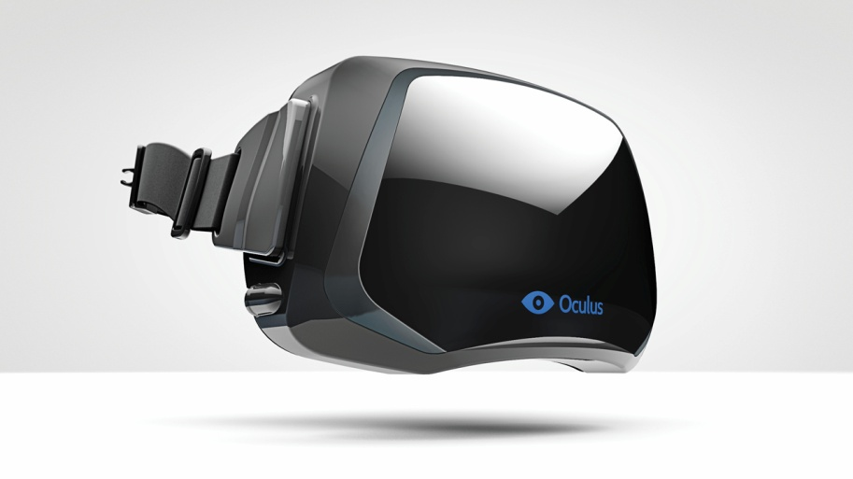
Оборудование
Multi-touch panel
Oculus Rift

Slide 4
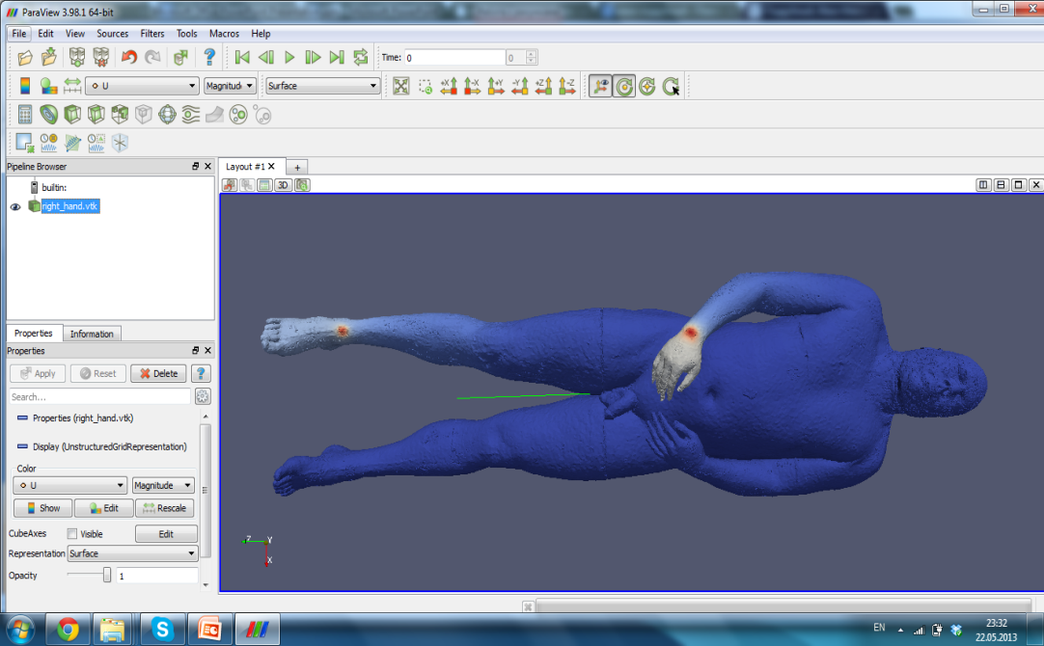
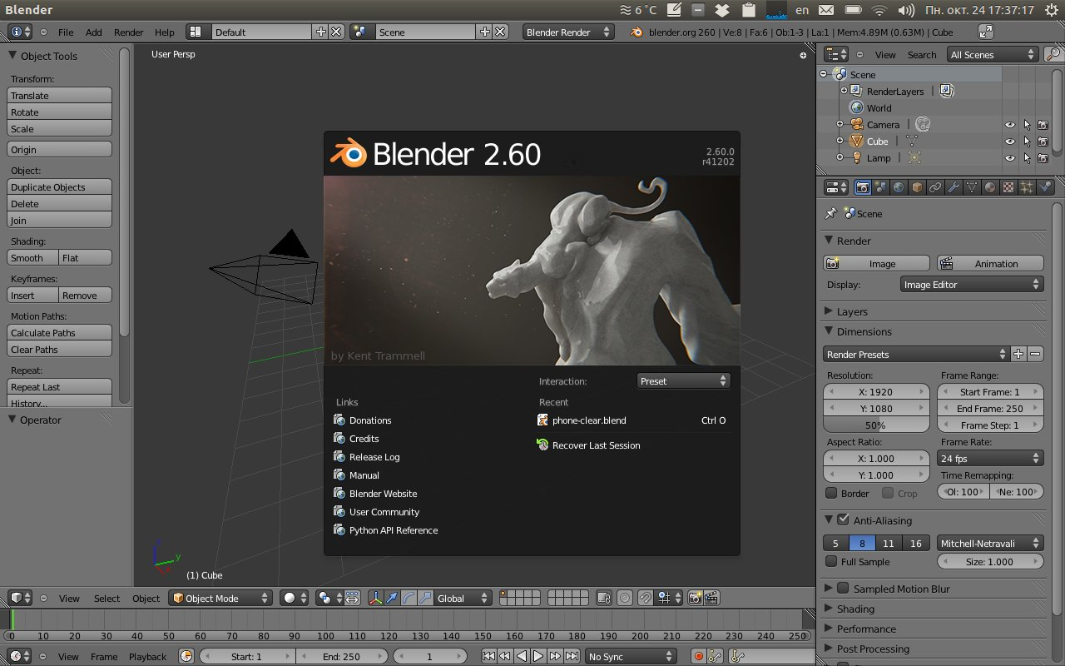
Programs, used in interface
Paraview
Blender
Progam for solution analisys
Program for dealing with complex 3D objects

Slide 5
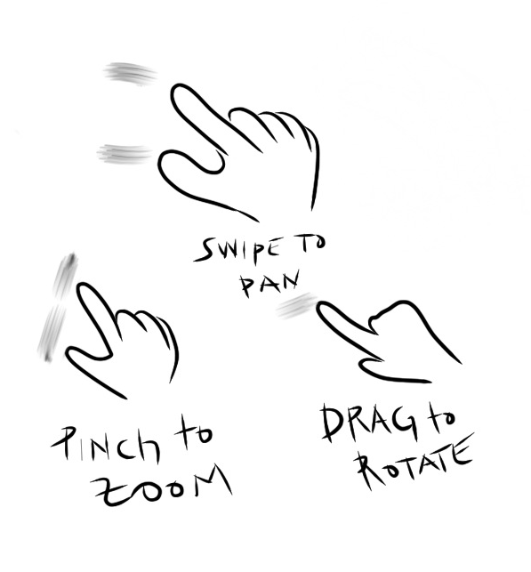
Simple gestures
Pan
Zoom
3D Rotate

Slide 6
Demonstration of this interface
Notes:
2 мин 40 сек

Slide 7
Simulation results

Slide 8
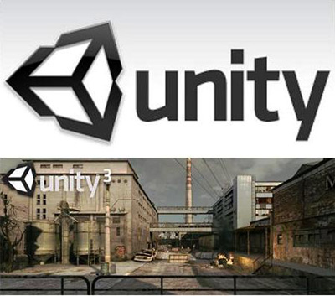
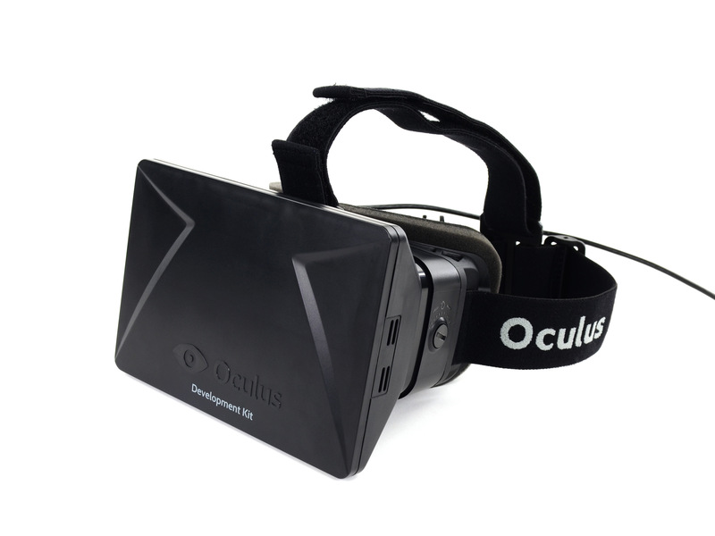
Base of new version of interface
Unity
Oculus Rift

Slide 9
Conclusion
Two interfaces created for simplification of mathematical models using
The foundatin of more complex interface was laid.

Slide 10
Thank you for your attention

